Slide 1
Cohesive Subgraphs
Detection
COMP9312_22T2

Slide 2
Notice
Census date
26 Jun 2022, 11:59pm
Assignment 1 Due
24 Jun 2022, 9:00 pm
Guest Lecture on Monday Week 5

Slide 3
Outline
Basic Concepts
Applications
Models and Algorithms

Slide 4
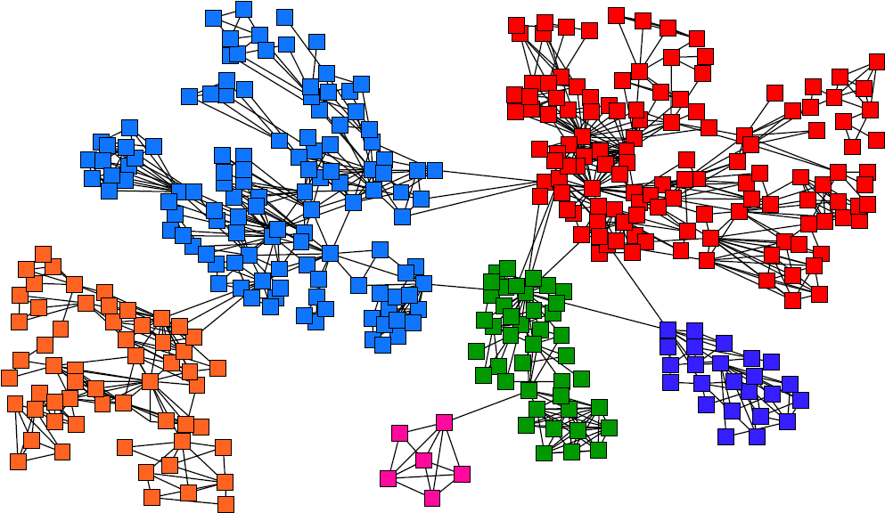
Community structure in graphs
Community structure: a cohesive group of nodes that are connected
"more densely" to each other than to the nodes in other communities
- Within-group (intra-group) edges.
High density
- Between-group (inter-group) edges.
Low density
Community structures are quite common in real networks.

Slide 5
Finding Communities
Who tend to work together
Information Retrieval
Co-author network
Machine learning
Data Mining
Q.Mei, D.Cai, D.Zhang, and C.Zhai, Topic Modeling with Hitting Time, WWW 2008
Notes:
-

Slide 6
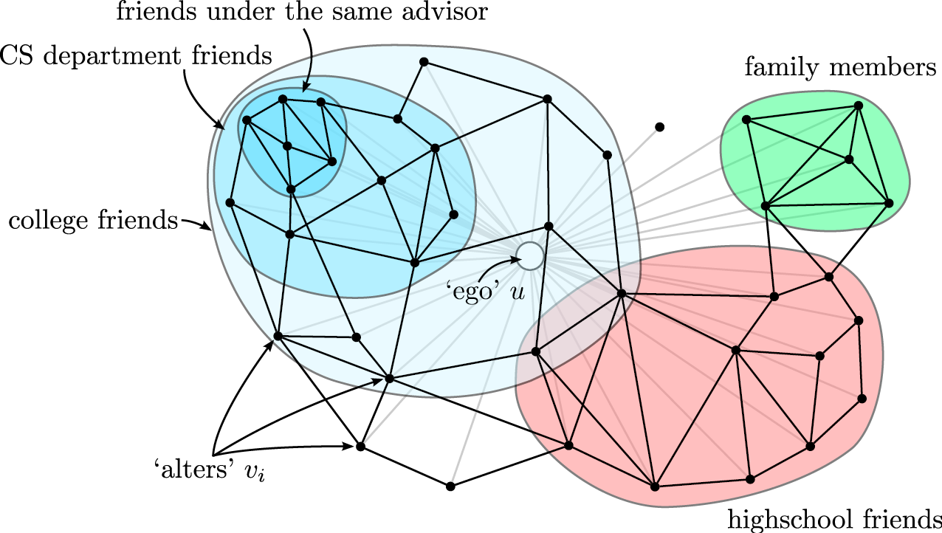
Finding Communities (Facebook or Twitter)
[McAuley, Leskovec: Discovering social circles in ego networks, 2012]
Notes:
-

Slide 7
How to measure group cohesion?
Mutuality of ties
- everybody in the group knows everybody else (clique)
frequency of ties among members
- everybody in the group has links to at least k others in the group
(k-core)
Others: density, quasi-clique, k-truss, k-edge connected component, etc.

Slide 8
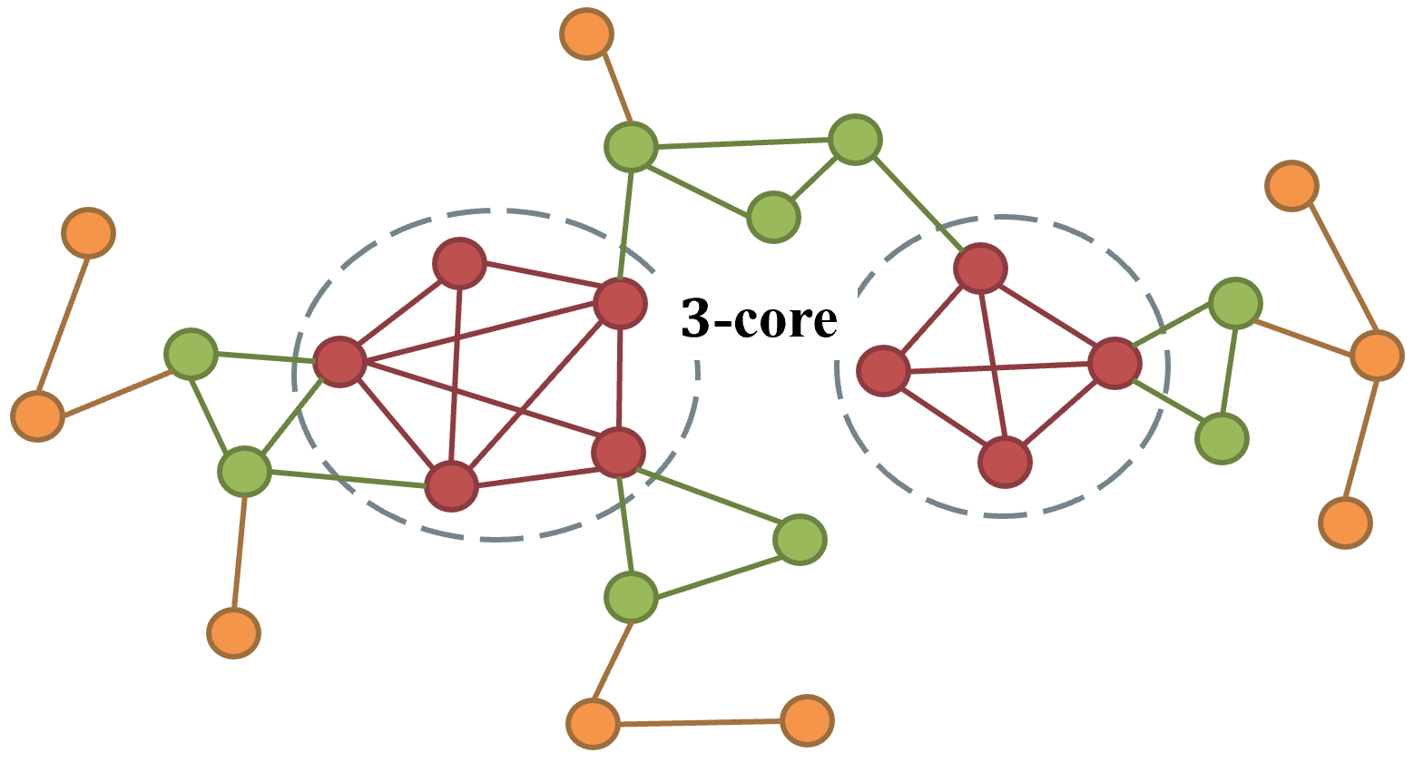
Cohesive Subgraphs
In some models, a value 𝑘 can be used to capture the cohesiveness of the subgraph. For example, 𝑘-core is a maximal subgraph in which each vertex has at least k neighbors in the subgraph.

Slide 9
Application Summary
Network Modeling and Analysis
Network Visualization
Reasoning the Collapse of a Network
Discovering Influential Nodes
Community Discovery
Anomaly Detection
Protein Function Prediction
……

Slide 10
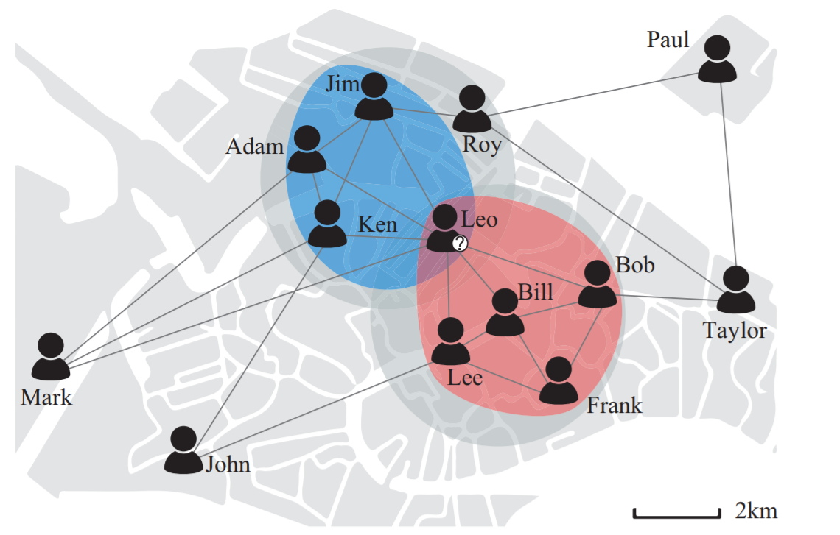
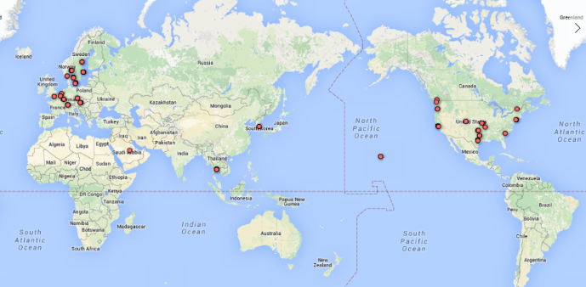
Application – Community Discovery
Social networks: persistent community search [ICDE 2018], spatial community search [ICDE 2018], attributed community detection [VLDB 2017] [VLDB 2017] [VLDB 2018] , influential community search [VLDB 2015]
A geo-social network
Communities in Gowalla

Slide 11
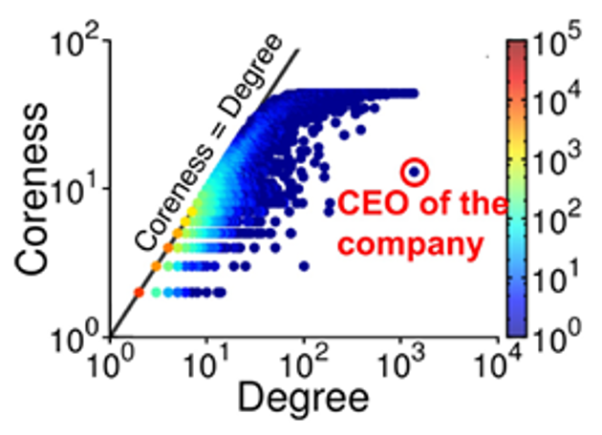
Application – Network Modeling and Analysis
Complex networks: pattern and anomaly analysis using k-core analysis [ICDM 2016] [KAIS 2018]

Slide 12
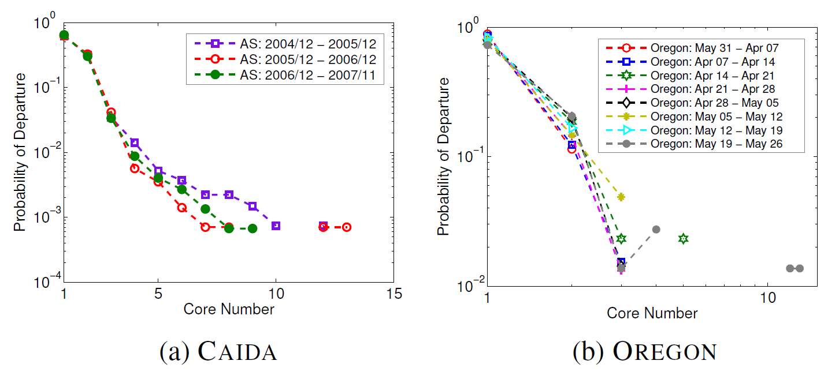
Application – Network Modeling and Analysis
Social networks: modeling engagement dynamics in social graphs [CIKM 2013] [Social Networks 1983]

Slide 13
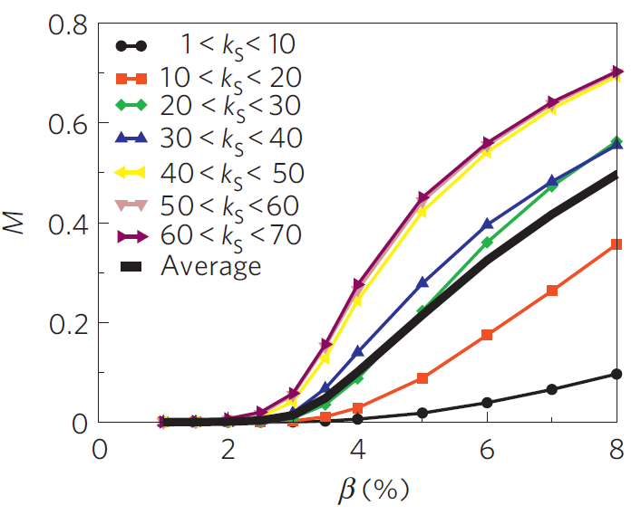
Application – Discovering Influential Nodes
The most effective spreaders are located in the core of the network, fairly independent of their degree. Influence of the infection probability beta on the spreading efficiency M of nodes, grouped according to their k-shell values [Nature Physics 2010]
Notes:
Influence of the infection probability \beta on the spreading efficiency M of nodes, grouped according to their k-shell
values, for SIR spreading. The solid black line refers to the average infected percentage over all network nodes. Nodes in higher-k shells are consistently the
most efficient, independently of the value.
the best spreaders do not correspond to the most highly connected or
the most central people. Instead, we find that the most efficient
spreaders are those located within the core of the network
as identified by the k-shell decomposition analysis, and
that when multiple spreaders are considered simultaneously
the distance between them becomes the crucial parameter that
determines the extent of the spreading

Slide 14
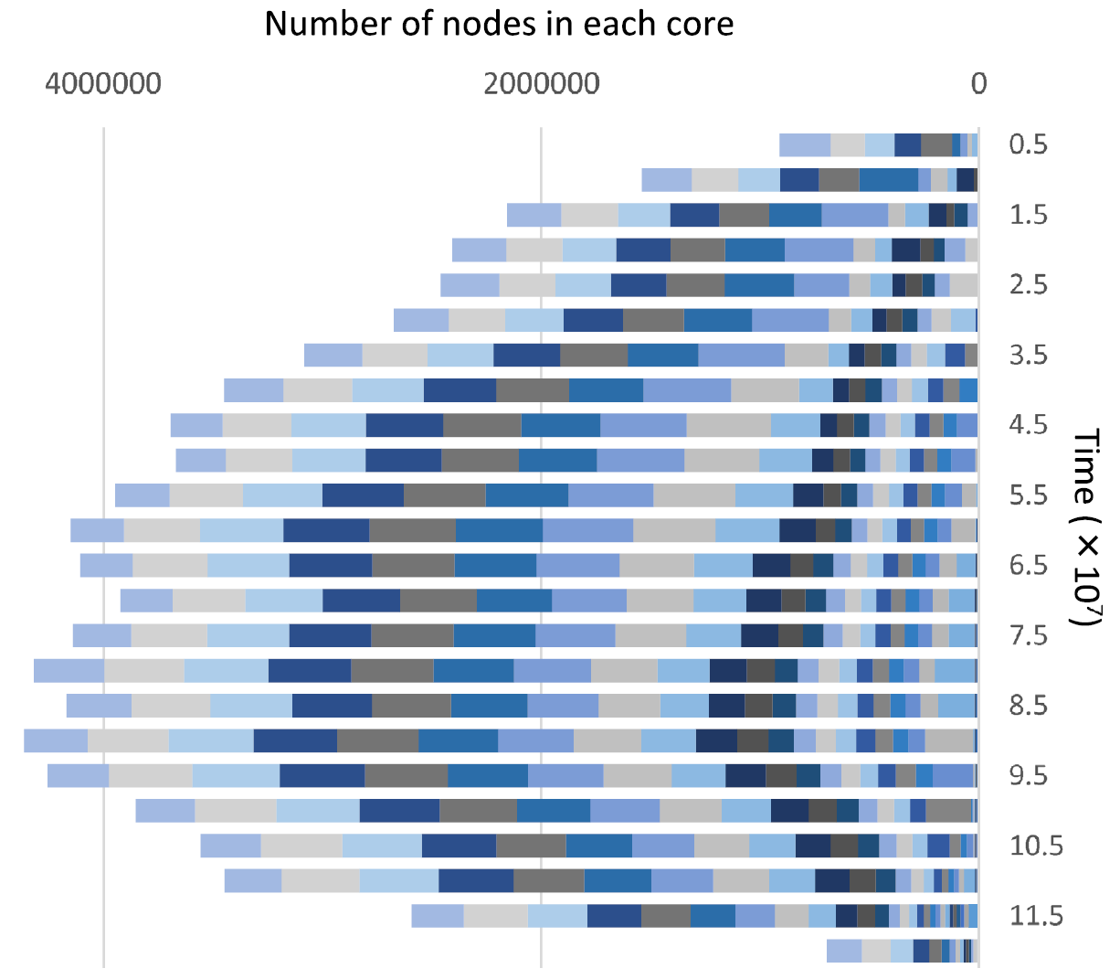
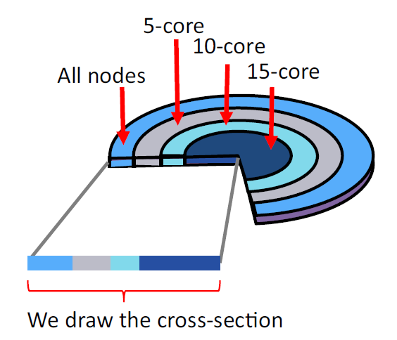
Application – Reasoning the Evolvement of a Social Network
Friendster network: revealing the mechanism of collapse [SNAM 2017] [COSN 2013]
Notes:
It is shown that the collapse of the Friendster network started from the ‘‘center’’
of the core structure. Following this result, we attempt to
explain its mechanism by a propagation model. We conclude
that the time evolution of core structure can be
explained by the two rules: (a) non-users who have many
friends on Friendster are likely to register for Friendster,
and (b) users who have many friends that have already left
Friendster are also likely to leave. The users who have few
friends on Friendster tend to leave soon and that may have
also played a key role in the time evolution of the core
structure. Moreover, under the assumption that our model
is valid, we discuss what to do to prevent the decline of
online communities. First, it is not effective to promote
registration in maintaining the number of active users.
Second, it is effective to promote non-active users to
become active again. Third, it is effective to persuade
influential users preferentially when we assume that the
chain reaction of coming back may occur.

Slide 15
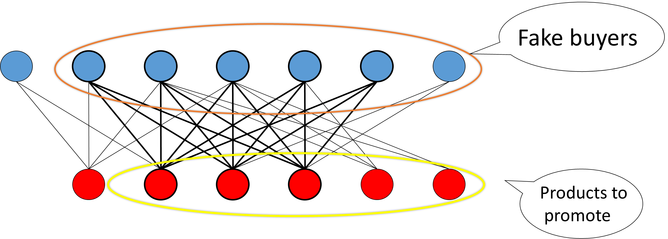
Application – Fraud Detection
User-item networks:
Challenges：
Billions of buyers and productions, 10+ billions of transactions
Dynamic data
Solution：Efficient biclique detection on bipartite graph
Outcome: Significantly increase the recall by 40% in double 11 festival in 2017
Lyu B, Qin L, Lin X, et al. Maximum Biclique Search at Billion Scale[J]. Proc. VLDB Endow., 2020, 13(9): 1359-1372. [Best paper runner-up award in VLDB 2020]
Notes:
ne typical application is anomaly detection in many scenarios including finance, insurance, and online shopping networks. For instance, on e-commerce platforms like eBay, Alibaba, and Amazon, user-product bipartite networks are prevalent [34], where each edge represents an interaction between a user and a product. In these platforms, the popularity of a product is heavily influenced by its ratings, reviews, and the numbers of sold items [33]. This phenomenon motivates many store-owners to mis-lead their users by providing fake ratings, reviews, or transactions .As studied in the literature, these malicious users and the products they promote often form a closely-connected group, which is very likely to be a maximum biclique [21]. In addition, many nowadays fraud detection techniques require a query seed (i.e., a confirmed risky account) as the input [4,22,26], where the seeds can be obtained by user reporting or other security mechanisms(e.g., monitoring accounts that make a large number of fake trans-actions within a short time period). When a seed is detected for any reason, other users in the personalized maximum biclique of this seed become highly suspicious and worth further human expert investigation.

Slide 16
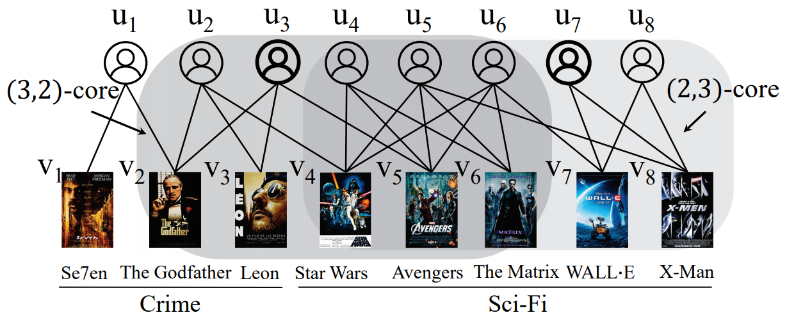
Application –Group Recommendation
Customer-movie network:
Ding D, Li H, Huang Z, et al. Efficient fault-tolerant group recommendation using alpha-beta-core[C] CIKM
Liu B, Yuan L, Lin X, et al. Efficient (α, β)-core computation: An index-based approach[C], CIKM. 2019: 1130-1141.
Notes:
Online Group recommendation aims at recommending products to a group of users who may or may not share similar tastes.
computing (α, β)-core in a Customer-movie network for given α and β can be used as recommending movies for friends to watch together

Slide 17
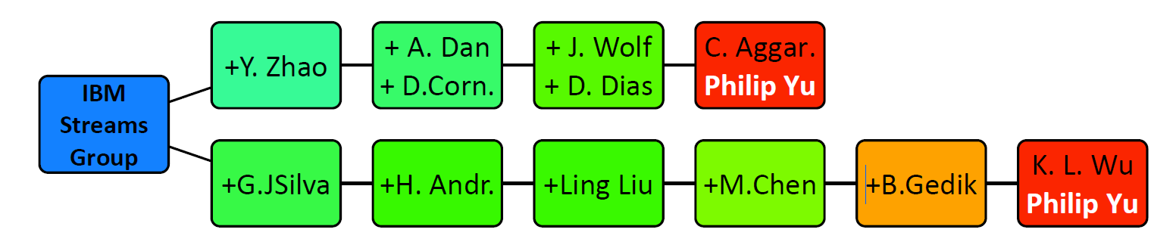
Application – Team Formation
Author-paper networks: analyzing the relationships between groups of collaborators in the same institution
Sarıyüce A E, Pinar A. Peeling bipartite networks for dense subgraph discovery[C]//Proceedings of the Eleventh ACM International Conference on Web Search and Data Mining. 2018: 504-512.
Notes:
author-paper network of the top database conferences. authors and papers can be the primary and secondary vertex sets,
with an edge representing authorship
The subgraphs reported by Wing in the dbconf network that contains
Philip Yu. Densities are color coded. Two chains show the collaborations
in the IBM Research’s Streams group, where the parent subgraph (left-most)
contains 76 researchers that contains staff members and intern students.
Tracing the hierarchical relations from Philip Yu’s subgraph(s)
Sariyuce A E, Pinar A. Butterfly Effect: Peeling Bipartite Networks[R]. Sandia National Lab.(SNL-CA), Livermore, CA (United States), 2016.

Slide 18
More Applications
Graph clustering
Giatsidis, Christos, et al. "Corecluster: A degeneracy based graph clustering framework." AAAI. 2014.
Graph similarity
Nikolentzos, Giannis, et al. "A Degeneracy Framework for Graph Similarity." IJCAI. 2018.
Community evaluation
Giatsidis, Christos, Dimitrios M. Thilikos, and Michalis Vazirgiannis. "Evaluating cooperation in communities with the k-core structure." ASONAM, 2011.
Influence maximization
Elsharkawy, Sarah, et al. "Effectiveness of the k-core nodes as seeds for influence maximisation in dynamic cascades." International Journal of Computers 2 (2017).
Graph generating
Baur, Michael, et al. "Generating graphs with predefined k-core structure." Proceedings of the European Conference of Complex Systems. 2007.

Slide 19
Degree-based Models: K-Core and its Variants

Slide 20
K-Core
K-core is a maximal connected subgraph in which each vertex has at least k neighbors in the subgraph
Erdős, Paul, and András Hajnal. "On chromatic number of graphs and set-systems." Acta Mathematica Hungarica 17.1-2 (1966): 61-99.

Slide 21

Graph Degeneracy ($k_{max}$)
The largest k such that the k-core is not empty, which is also called the degeneracy.

Slide 22
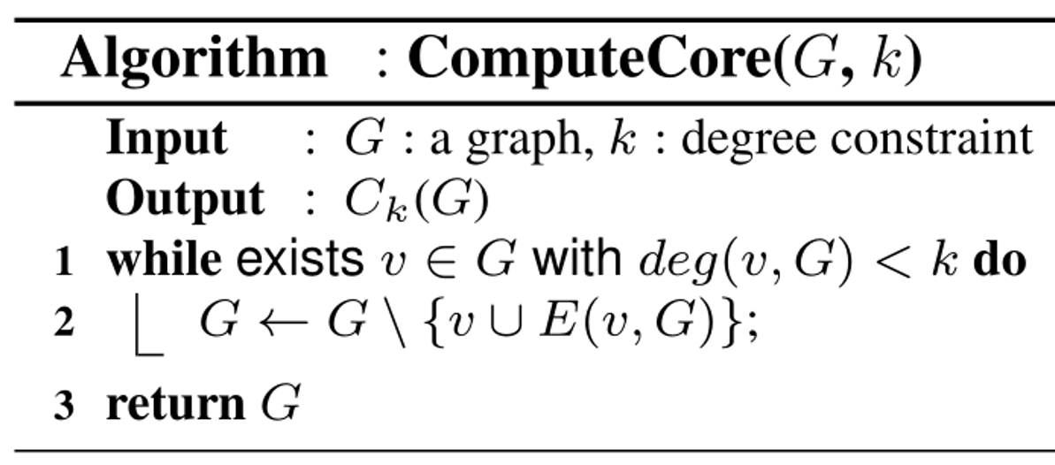
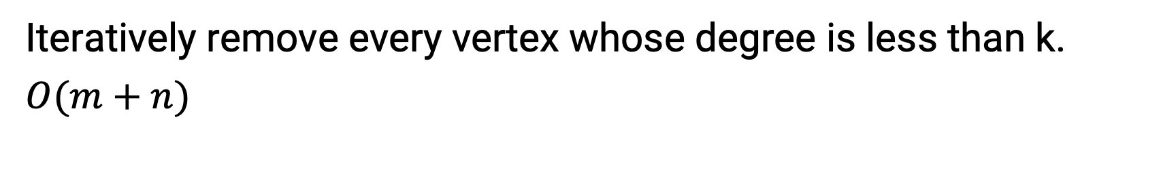
Computing k-Core
Iteratively remove every vertex whose degree is less than k.
$O(m+n)$

Slide 23
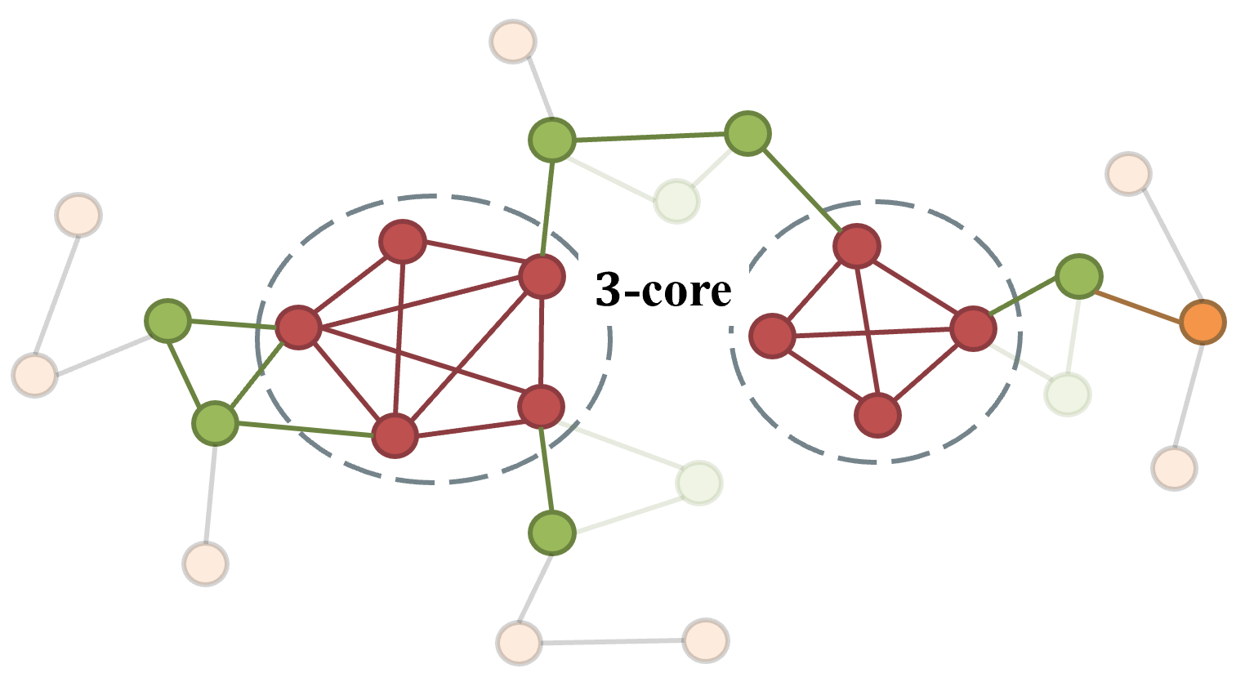
Computing k-Core
Iteratively remove every vertex whose degree is less than k.
$O(m+n)$

Slide 24
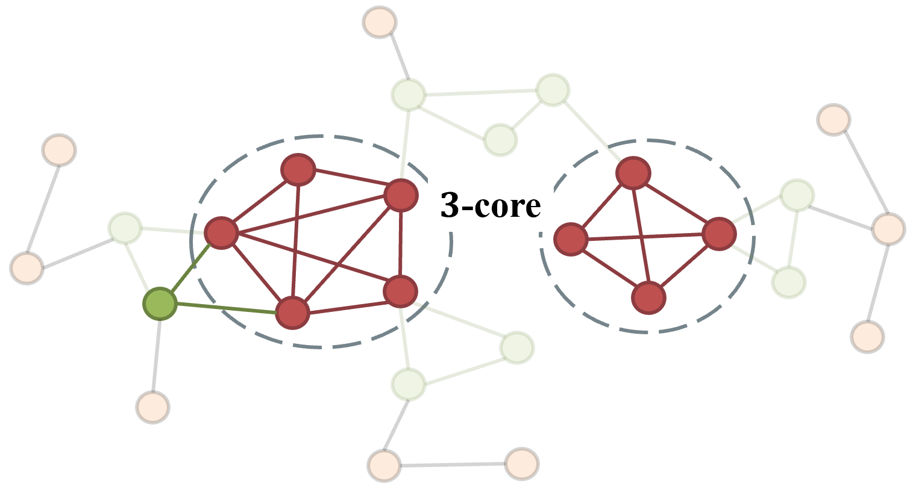
Computing k-Core
Iteratively remove every vertex whose degree is less than k.
$O(m+n)$

Slide 25
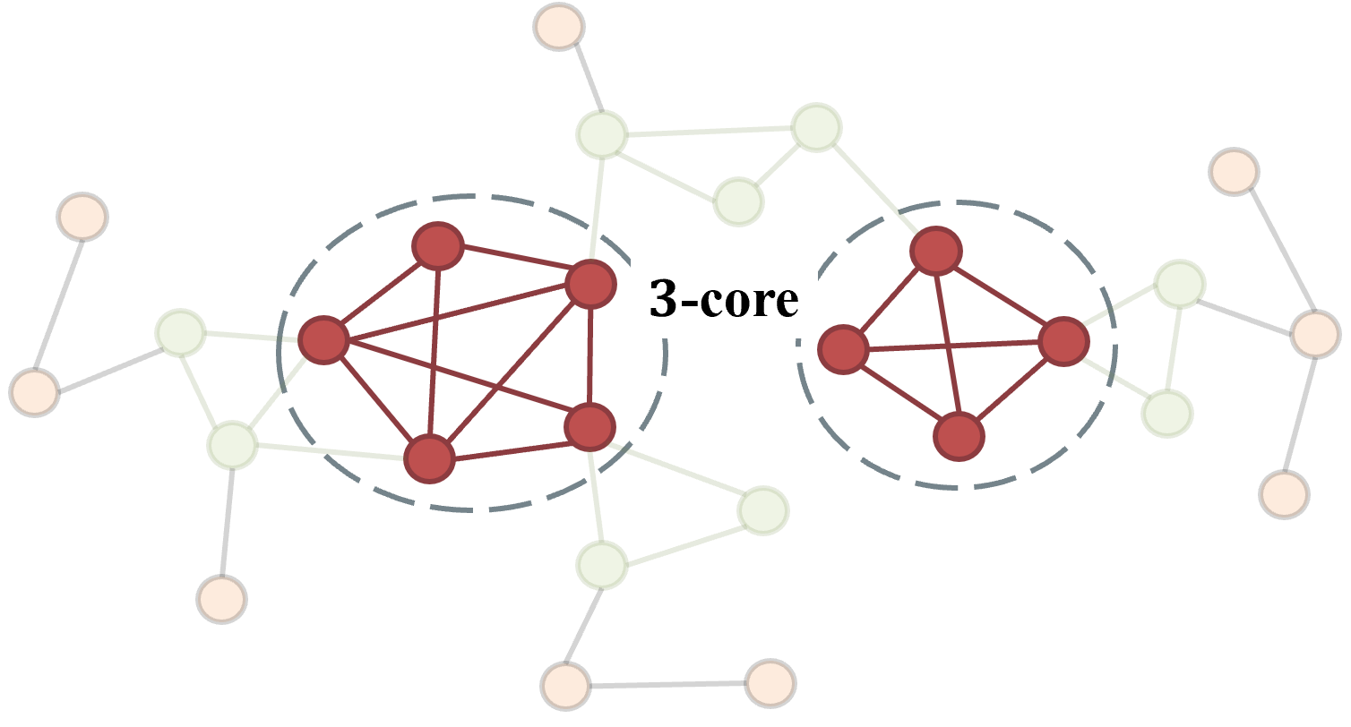
Computing k-Core
Iteratively remove every vertex whose degree is less than k.
$O(m+n)$

Slide 26
Example: Online k-core computation
Iteratively remove every vertex whose degree is less than k.
1
2
This table lists the status of the vertices:
12
3
4
vertex | 1 | 2 | 3 | 4 | 5 | 6 | 7 | 8 | 9 | 10 | 11 | 12 | 13 | 14
Delete | F | F | F | F | F | F | F | F | F | F | F | F | F | F
14
13
5
11
7
6
8
9
Find 3-core in this graph:
10

Slide 27
Example: Online k-core computation
Iteratively remove every vertex whose degree is less than k.
1
deg(v1)=1, deg(v9)=2, deg(v10)=1.
The degree of vertex 1, 9, 10 are smaller than 3, so we need to delete them.
2
12
3
4
vertex | 1 | 2 | 3 | 4 | 5 | 6 | 7 | 8 | 9 | 10 | 11 | 12 | 13 | 14
Delete | T | F | F | F | F | F | F | F | T | T | F | F | F | F
14
13
5
11
7
6
8
9
Find 3-core in this graph:
10

Slide 28
Example: Online k-core computation
Iteratively remove every vertex whose degree is less than k.
deg(v2)=2, deg(v8)=2.
The degree of vertex 2, 8 is smaller than 3, so we need to delete them.
2
12
3
4
14
vertex | 1 | 2 | 3 | 4 | 5 | 6 | 7 | 8 | 9 | 10 | 11 | 12 | 13 | 14
Delete | T | T | F | F | F | F | F | T | T | T | F | F | F | F
13
5
11
7
6
8
Find 3-core in this graph:

Slide 29
Example: Online k-core computation
Iteratively remove every vertex whose degree is less than k.
deg(v3)=2.
The degree of vertex 3 is smaller than 3, so we need to delete it.
12
3
4
14
vertex | 1 | 2 | 3 | 4 | 5 | 6 | 7 | 8 | 9 | 10 | 11 | 12 | 13 | 14
Delete | T | T | T | F | F | F | F | T | T | T | F | F | F | F
13
5
11
7
6
Find 3-core in this graph:

Slide 30
Example: Online k-core computation
Iteratively remove every vertex whose degree is less than k.
The degree of all vertices is greater than 3, so the iteration is end. Then we get the result of 3-core.
12
4
14
vertex | 1 | 2 | 3 | 4 | 5 | 6 | 7 | 8 | 9 | 10 | 11 | 12 | 13 | 14
Delete | T | T | T | F | F | F | F | T | T | T | F | F | F | F
13
5
11
7
6
Find 3-core in this graph:

Slide 31
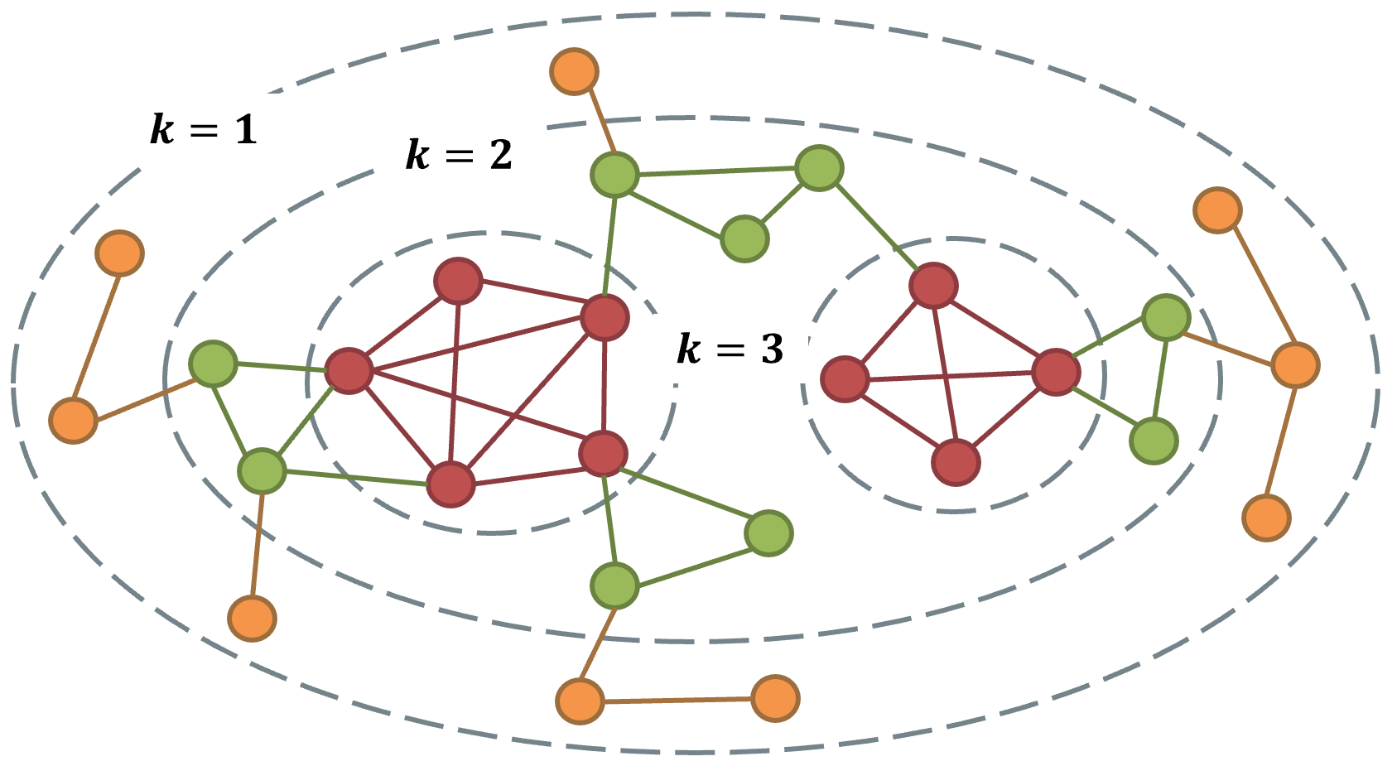
Core Number
Core number of a vertex $v$:
$k\left(v\right)$ = the largest k such that the k-core contains 𝑣

Slide 32
Core Decomposition
Compute the core number of every vertex.
Note: If we store the core number of every vertex offline, given a graph G and a parameter k, all the vertices in the k-core (denoted as C_{k}(V, E)) of G can be returned in O(|V(C_{k})|) time.
Tips: Store the vertices in decreasing order of their core numbers.

Slide 33
Core Decomposition (Cont.)
How to identify different groups?
There are two 3-cores in the example graph.

Slide 34
Core Decomposition: Methods
Global-view: peel low-degree vertices iteratively from the whole graph (which we introduce here).
Local-view: update the upper bound of core number for each vertex until converge.

Slide 35
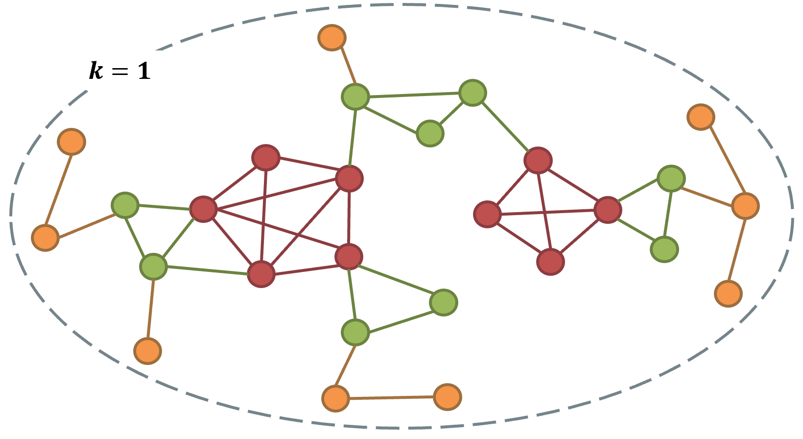
Core Decomposition: Global-view (Peeling)
For each unvisited vertex u with the lowest degree in G
assign core(u) as degree(u);
mark u as visited;
decrease the degree of its unvisited neighbors with higher degree than u by 1;

Slide 36
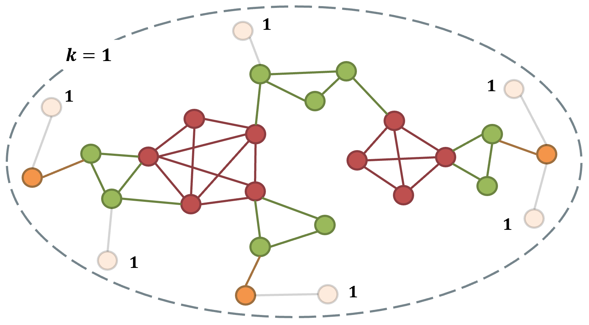
Core Decomposition: Global-view (Peeling)
For each unvisited vertex u with the lowest degree in G
assign core(u) as degree(u);
mark u as visited;
decrease the degree of its unvisited neighbors with higher degree than u by 1;

Slide 37
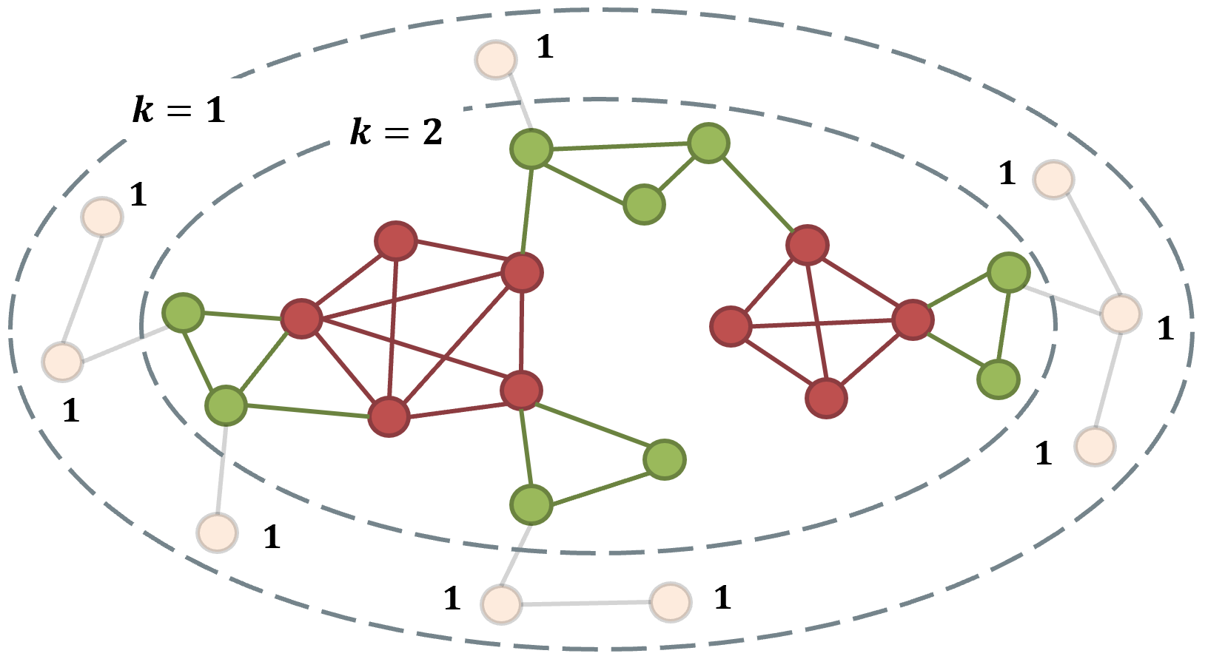
Core Decomposition: Global-view (Peeling)
For each unvisited vertex u with the lowest degree in G
assign core(u) as degree(u);
mark u as visited;
decrease the degree of its unvisited neighbors with higher degree than u by 1;

Slide 38
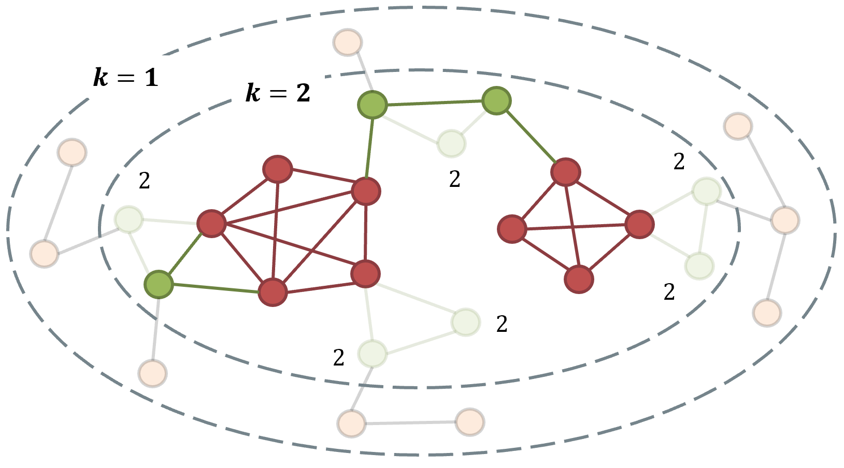
Core Decomposition: Global-view (Peeling)
For each unvisited vertex u with the lowest degree in G
assign core(u) as degree(u);
mark u as visited;
decrease the degree of its unvisited neighbors with higher degree than u by 1;

Slide 39
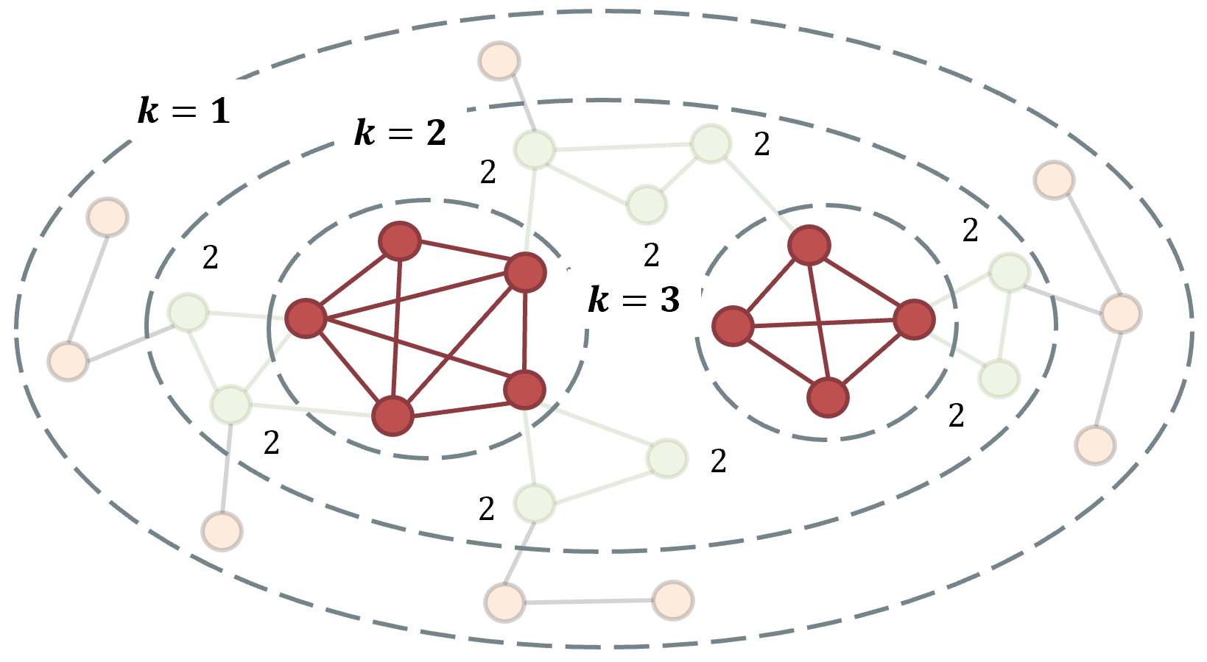
Core Decomposition: Global-view (Peeling)
For each unvisited vertex u with the lowest degree in G
assign core(u) as degree(u);
mark u as visited;
decrease the degree of its unvisited neighbors with higher degree than u by 1;

Slide 40
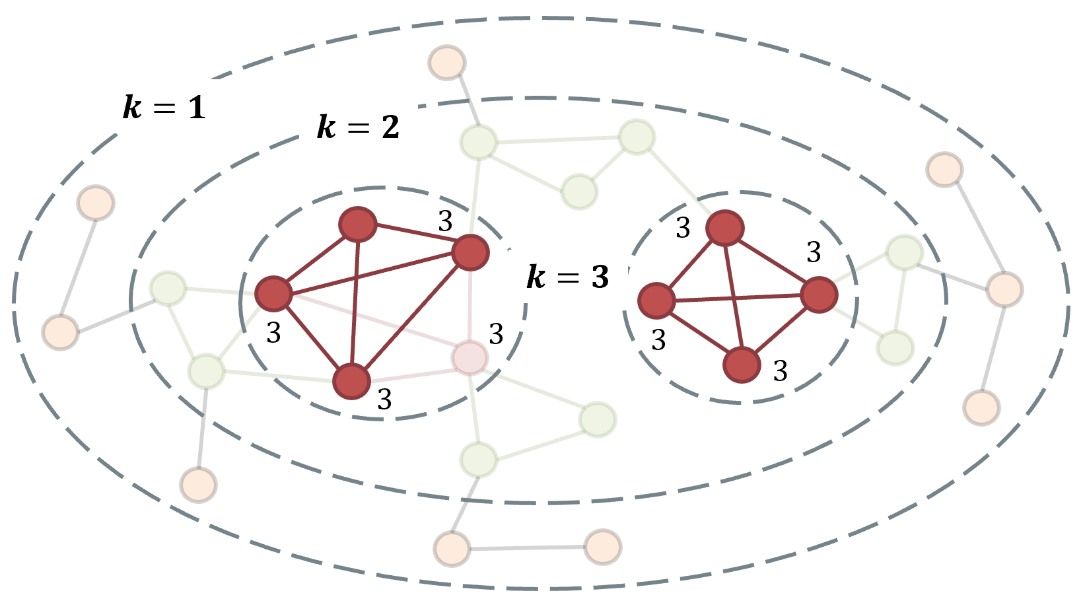
Core Decomposition: Global-view (Peeling)
For each unvisited vertex u with the lowest degree in G
assign core(u) as degree(u);
mark u as visited;
decrease the degree of its unvisited neighbors with higher degree than u by 1;

Slide 41
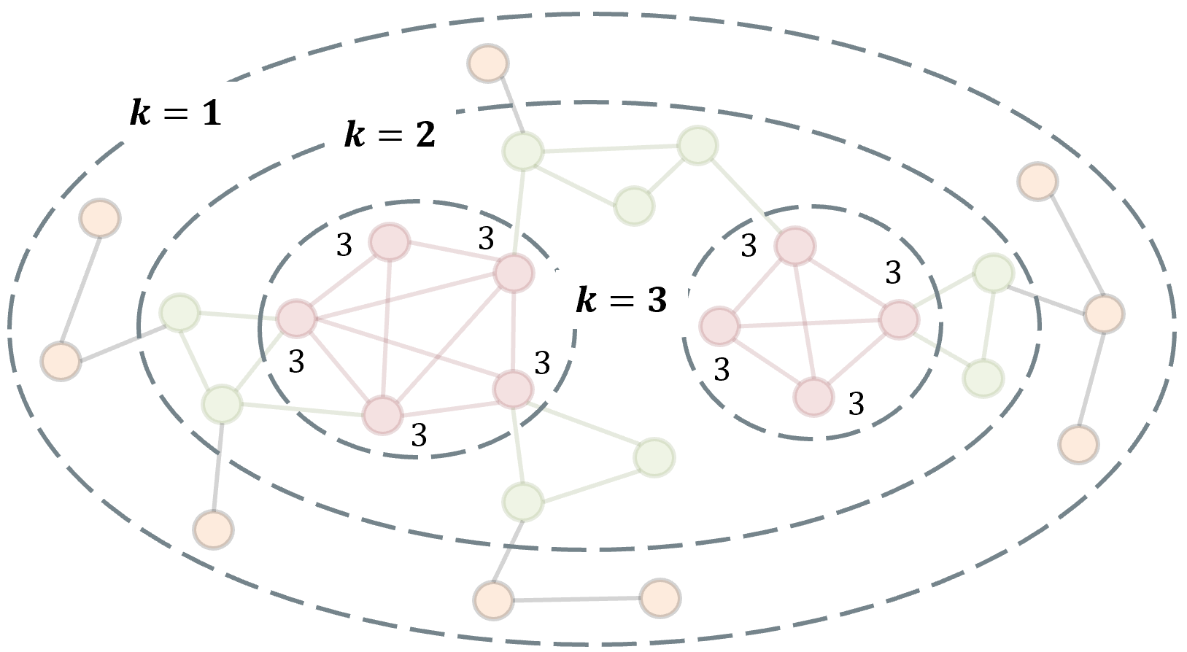
Core Decomposition: Global-view (Peeling)
For each unvisited vertex u with the lowest degree in G
assign core(u) as degree(u);
mark u as visited;
decrease the degree of its unvisited neighbors with higher degree than u by 1;

Slide 42
Core Decomposition: Global-view (Peeling)
For each unvisited vertex u with the lowest degree in G
assign core(u) as degree(u);
mark u as visited;
decrease the degree of its unvisited neighbors with higher degree than u by 1;

Slide 43

Example: O($n^{2}$) Algorithm for Core Decomposition
A
degree | 1 | 3 | 4 | 3 | 2 | 5 | 4 | 3 | 3
vertex | A | B | C | D | E | F | G | H | I
B
G
D
C
I
H
Iterate over all the vertices. For a deleting vertex v, if the degree of its unvisited neighbor u is greater than the degree of v, then decrease the degree of u by one.
E
F

Slide 44


Example: O($n^{2}$) Algorithm for Core Decomposition
Start from the vertex A, A’s neighbor is B.
A
degree | 1 | 3 | 4 | 3 | 2 | 5 | 4 | 3 | 3
vertex | A | B | C | D | E | F | G | H | I
B
G
D
C
I
H
degree[B]>degree[A],
then degree[B]$←$degree[B]-1, degree[B]=2.
E
F
degree | 1 | 2 | 4 | 3 | 2 | 5 | 4 | 3 | 3
vertex | A | B | C | D | E | F | G | H | I

Slide 45
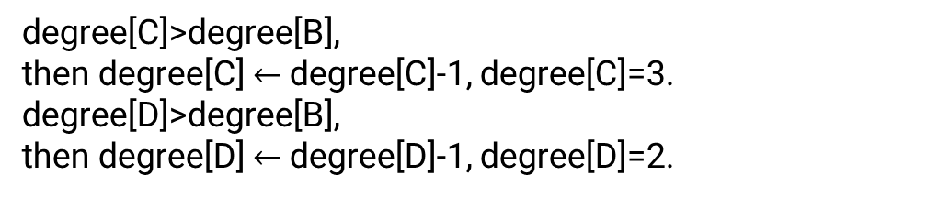
Example: O($n^{2}$) Algorithm for Core Decomposition
The next vertex is B, B’s unvisited neighbors are C and D.
A
degree | 1 | 2 | 4 | 3 | 2 | 5 | 4 | 3 | 3
vertex | A | B | C | D | E | F | G | H | I
B
G
D
C
I
H
degree[C]>degree[B],
then degree[C] $←$degree[C]-1, degree[C]=3.
degree[D]>degree[B],
then degree[D] $←$degree[D]-1, degree[D]=2.
E
F
degree | 1 | 2 | 3 | 2 | 2 | 5 | 4 | 3 | 3
vertex | A | B | C | D | E | F | G | H | I

Slide 46
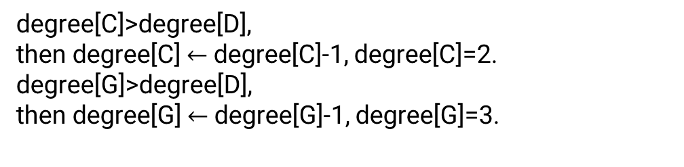
Example: O($n^{2}$) Algorithm for Core Decomposition
The next vertex with the smallest degree is D,
D’s unvisited neighbors are C and G.
A
degree | 1 | 2 | 3 | 2 | 2 | 5 | 4 | 3 | 3
vertex | A | B | C | D | E | F | G | H | I
B
G
D
C
degree[C]>degree[D],
then degree[C] $←$degree[C]-1, degree[C]=2.
degree[G]>degree[D],
then degree[G] $←$degree[G]-1, degree[G]=3.
I
H
E
F
degree | 1 | 2 | 2 | 2 | 2 | 5 | 3 | 3 | 3
vertex | A | B | C | D | E | F | G | H | I

Slide 47
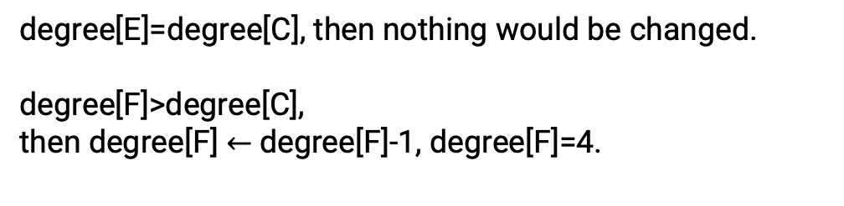
Example: O($n^{2}$) Algorithm for Core Decomposition
The next vertex with the smallest degree is C,
C’s unvisited neighbor is E.
A
degree | 1 | 2 | 2 | 2 | 2 | 5 | 3 | 3 | 3
vertex | A | B | C | D | E | F | G | H | I
B
G
D
C
degree[E]=degree[C], then nothing would be changed.
degree[F]>degree[C],
then degree[F] $←$degree[F]-1, degree[F]=4.
I
H
E
F
degree | 1 | 2 | 2 | 2 | 2 | 4 | 3 | 3 | 3
vertex | A | B | C | D | E | F | G | H | I

Slide 48

Example: O($n^{2}$) Algorithm for Core Decomposition
The next vertex with the smallest degree is E,
E’s unvisited neighbor is F.
A
degree | 1 | 2 | 2 | 2 | 2 | 4 | 3 | 3 | 3
vertex | A | B | C | D | E | F | G | H | I
B
G
D
C
degree[F]>degree[E],
then degree[F] $←$degree[F]-1, degree[F]=3.
I
H
E
F
degree | 1 | 2 | 2 | 2 | 2 | 3 | 3 | 3 | 3
vertex | A | B | C | D | E | F | G | H | I

Slide 49
Example: O($n^{2}$) Algorithm for Core Decomposition
The next vertex with the smallest degree is G,
G’s unvisited neighbors are F, H and I.
A
degree | 1 | 2 | 2 | 2 | 2 | 3 | 3 | 3 | 3
vertex | A | B | C | D | E | F | G | H | I
B
G
D
C
degree[H]=degree[G], degree[I]=degree[G], degree[F]=degree[G], then nothing would be changed.
I
H
E
F
degree | 1 | 2 | 2 | 2 | 2 | 3 | 3 | 3 | 3
vertex | A | B | C | D | E | F | G | H | I

Slide 50
Example: O($n^{2}$) Algorithm for Core Decomposition
The next vertex with the smallest degree is F,
F’s unvisited neighbors are H and I.
A
degree | 1 | 2 | 2 | 2 | 2 | 3 | 3 | 3 | 3
vertex | A | B | C | D | E | F | G | H | I
B
G
D
C
degree[H]=degree[F], degree[I]=degree[F],
then nothing would be changed.
I
H
E
F
degree | 1 | 2 | 2 | 2 | 2 | 3 | 3 | 3 | 3
vertex | A | B | C | D | E | F | G | H | I

Slide 51
Example: O($n^{2}$) Algorithm for Core Decomposition
The next vertex with the smallest degree is H, H’s unvisited neighbor is I.
A
degree | 1 | 2 | 2 | 2 | 2 | 3 | 3 | 3 | 3
vertex | A | B | C | D | E | F | G | H | I
B
G
D
C
degree[I]=degree[H], then nothing would be changed.
I
H
E
degree | 1 | 2 | 2 | 2 | 2 | 3 | 3 | 3 | 3
vertex | A | B | C | D | E | F | G | H | I
F

Slide 52
Example: O($n^{2}$) Algorithm for Core Decomposition
A
degree | 1 | 2 | 2 | 2 | 2 | 3 | 3 | 3 | 3
vertex | A | B | C | D | E | F | G | H | I
B
G
D
C
I
H
E
The decomposition process is complete.
F

Slide 53
Quick exercise
Could you tell me the core number of each vertex?
A
B
G
D
C
E
F

Slide 54
Example: O($n^{2}$) Algorithm for Core Decomposition
The time complexity of the whole process is O(n²+m) = O(n²).
Need to get the vertex with minimum degree in each iteration:
Using heap (priority queue): O(m*log(n))
Using Fabonacci heap: O(m+n*log(n))
Any better solution?

Slide 55
Core Decomposition using Doubly Linked List
For each degree d, store all vertices with degree d using a doubly linked list (DLL)
When the degree of a vertex u decreases, move u from old DLL to a new DLL.
Time complexity: O(m)
Drawback: cannot fully utilize CPU cache~

Slide 56
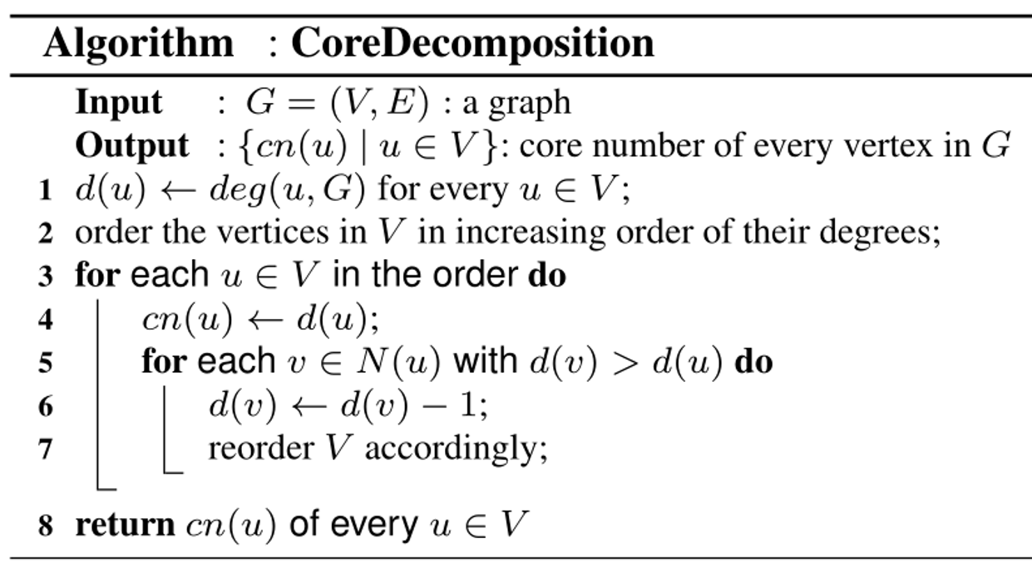
Core Decomposition using Flat Array
A
B
In order to achieve the time complexity of O(m), we first sort all vertices according to their degree.
G
D
C
I
H
degree | 1 | 2 | 3 | 3 | 3 | 3 | 4 | 4 | 5
vertex | A | E | D | B | I | H | G | C | F
E
F
Iterate over all the vertices. If the degree of neighbouring vertex u of vertex v is greater than the degree of v, decrease the degree of u by 1. Then, for the line 7, swap the positions of u and the first vertex with the same degree as u’s original degree. Because we use the bin sort, the time complexity of reorder the array is O(n). Thus, the total time complexity for core decomposition is O(m).

Slide 57
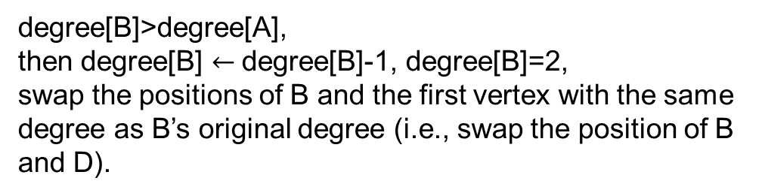
Core Decomposition using Flat Array
Loop according to the order of degrees in the table, start from the vertex A with the minimum degree.
A
degree | 1 | 2 | 3 | 3 | 3 | 3 | 4 | 4 | 5
vertex | A | E | D | B | I | H | G | C | F
B
G
D
C
degree[B]>degree[A],
then degree[B] $←$degree[B]-1, degree[B]=2,
swap the positions of B and the first vertex with the same degree as B’s original degree (i.e., swap the position of B and D).
I
H
E
F
degree | 1 | 2 | 2 | 3 | 3 | 3 | 4 | 4 | 5
vertex | A | E | B | D | I | H | G | C | F

Slide 58
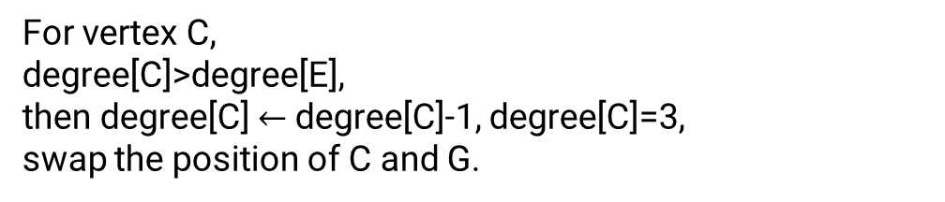
Core Decomposition using Flat Array
The next vertex in the table is E, E’s neighbors are C and F.
A
degree | 1 | 2 | 2 | 3 | 3 | 3 | 4 | 4 | 5
vertex | A | E | B | D | I | H | G | C | F
B
G
D
C
For vertex C,
degree[C]>degree[E],
then degree[C] $←$degree[C]-1, degree[C]=3,
swap the position of C and G.
I
H
E
F
degree | 1 | 2 | 2 | 3 | 3 | 3 | 3 | 4 | 5
vertex | A | E | B | D | I | H | C | G | F

Slide 59
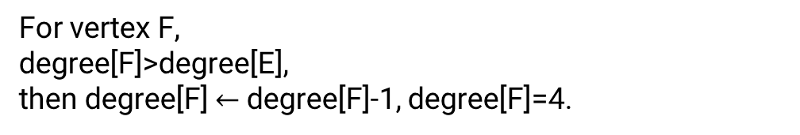
Core Decomposition using Flat Array
The next vertex in the table is E, E’s neighbors are C and F.
A
degree | 1 | 2 | 2 | 3 | 3 | 3 | 3 | 4 | 5
vertex | A | E | B | D | I | H | C | G | F
B
G
D
C
I
For vertex F,
degree[F]>degree[E],
then degree[F] $←$degree[F]-1, degree[F]=4.
H
E
F
degree | 1 | 2 | 2 | 3 | 3 | 3 | 3 | 4 | 4
vertex | A | E | B | D | I | H | C | G | F

Slide 60
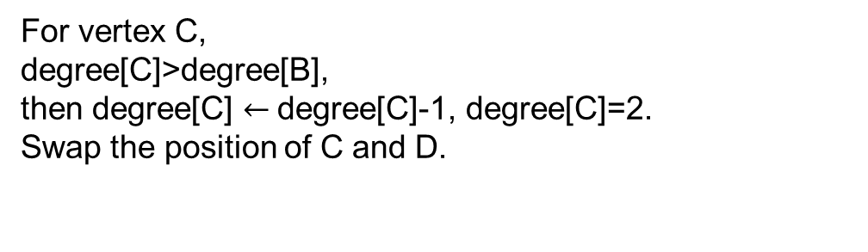
Core Decomposition using Flat Array
The next vertex in the table is B, B’s unvisited neighbors are C and D.
A
degree | 1 | 2 | 2 | 3 | 3 | 3 | 3 | 4 | 4
vertex | A | E | B | D | I | H | C | G | F
B
G
D
C
For vertex C,
degree[C]>degree[B],
then degree[C] $←$degree[C]-1, degree[C]=2.
Swap the position of C and D.
I
H
E
F
degree | 1 | 2 | 2 | 2 | 3 | 3 | 3 | 4 | 4
vertex | A | E | B | C | I | H | D | G | F

Slide 61
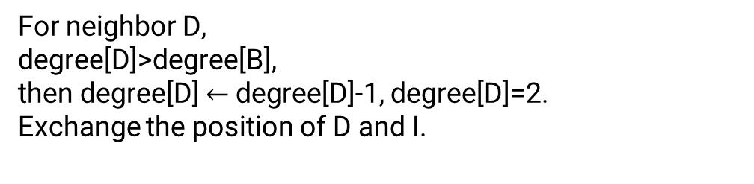
Core Decomposition using Flat Array
The next vertex in the table is B, B’s neighbors are C and D.
A
degree | 1 | 2 | 2 | 2 | 3 | 3 | 3 | 4 | 4
vertex | A | E | B | C | I | H | D | G | F
B
G
D
C
For neighbor D,
degree[D]>degree[B],
then degree[D] $←$degree[D]-1, degree[D]=2.
Exchange the position of D and I.
I
H
E
F
degree | 1 | 2 | 2 | 2 | 2 | 3 | 3 | 4 | 4
vertex | A | E | B | C | D | H | I | G | F

Slide 62
Core Decomposition using Flat Array
The next vertex in the table is C, C’s unvisited neighbors are D and F.
A
degree | 1 | 2 | 2 | 2 | 2 | 3 | 3 | 4 | 4
vertex | A | E | B | C | D | H | I | G | F
B
G
D
C
For vertex D, the degree are equal to degree[C]
Then the order of table would not change.
degree[F] is updated to 3.
Exchange the position of F and G.
I
H
E
F
degree | 1 | 2 | 2 | 2 | 2 | 3 | 3 | 3 | 4
vertex | A | E | B | C | D | H | I | F | G

Slide 63
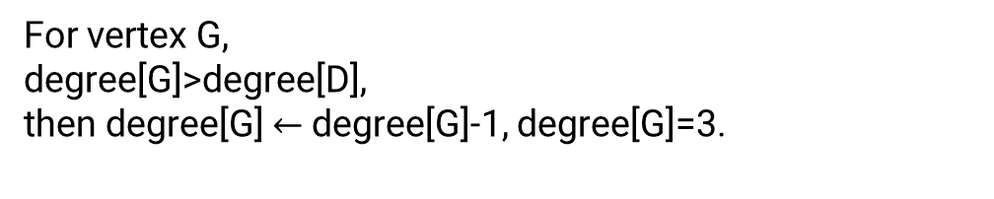
Core Decomposition using Flat Array
The next vertex in the table is D, D’s unvisited neighbor is G.
A
degree | 1 | 2 | 2 | 2 | 2 | 3 | 3 | 3 | 4
vertex | A | E | B | C | D | H | I | F | G
B
G
D
C
For vertex G,
degree[G]>degree[D],
then degree[G] $←$degree[G]-1, degree[G]=3.
I
H
E
F
degree | 1 | 2 | 2 | 2 | 2 | 3 | 3 | 3 | 3
vertex | A | E | B | C | D | H | I | F | G

Slide 64
Core Decomposition using Flat Array
The next vertex in the table is H, H’s unvisited neighbors are F, G and I.
A
degree | 1 | 2 | 2 | 2 | 2 | 3 | 3 | 3 | 3
vertex | A | E | B | C | D | H | I | F | G
B
G
D
C
I
For vertices F, G and I,
degree[F]=degree[G]= degree[H]=degree[I].
Then the order of table would not change.
H
E
F
degree | 1 | 2 | 2 | 2 | 2 | 3 | 3 | 3 | 3
vertex | A | E | B | C | D | H | I | F | G

Slide 65
Core Decomposition using Flat Array
The next vertex in the table is I, I’s unvisited neighbors are F and G.
A
degree | 1 | 2 | 2 | 2 | 2 | 3 | 3 | 3 | 3
vertex | A | E | B | C | D | H | I | F | G
B
G
D
C
For vertex F, G,
degree[F]=degree[G]= degree[I].
Then the order of table would not change.
I
H
E
F

Slide 66
Core Decomposition using Flat Array
The next vertex in the table is F, F’s unvisited neighbor is G
A
degree | 1 | 2 | 2 | 2 | 2 | 3 | 3 | 3 | 3
vertex | A | E | B | C | D | H | I | F | G
B
G
D
C
I
H
For vertex G, degree[G]=degree[F].
Then the order of table would not change.
E
F

Slide 67
Core Decomposition using Flat Array
A
The next vertex in the table is G, there is no G’s unvisited neighbor.
B
G
D
C
degree | 1 | 2 | 2 | 2 | 2 | 3 | 3 | 3 | 3
vertex | A | E | B | C | D | H | I | F | G
I
H
E
F

Slide 68
Core Decomposition using Flat Array
A
B
After we traverse all edges in this graph, we get the core number of each vertex in O(m) time.
G
D
C
I
H
E
degree | 1 | 2 | 2 | 2 | 2 | 3 | 3 | 3 | 3
vertex | A | E | B | C | D | H | I | F | G
F

Slide 69
Core Decomposition using Flat Array
A
B
G
D
C
What we need to implement the O(m) algorithm
An array to sort vertices in non-decreasing order of degree
An array to locate the start position for each degree
An array to get the position of each vertex id
An array to maintain the degree of each vertex
I
H
E
F
degree | 1 | 2 | 3 | 3 | 3 | 3 | 4 | 4 | 5
vertex | A | E | D | B | I | H | G | C | F

Slide 70
An example

Slide 71
Variants of K-Core （optional）

Slide 72
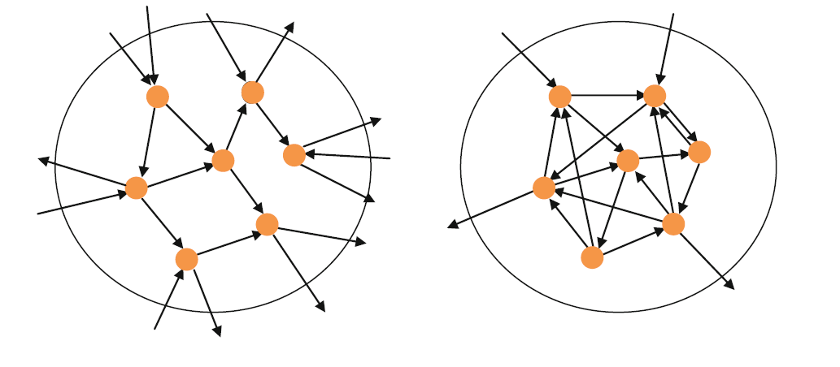
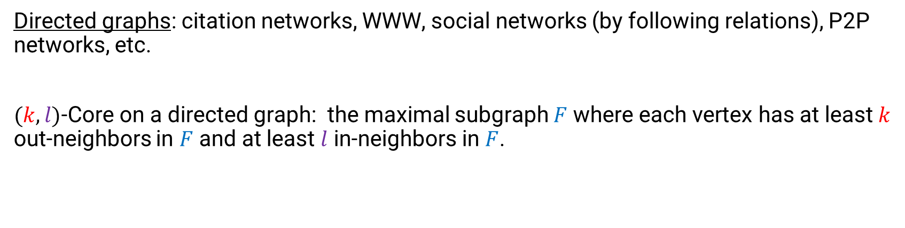
k-Core on Directed Graphs
Directed graphs: citation networks, WWW, social networks (by following relations), P2P networks, etc.
$(k,l)$-Core on a directed graph: the maximal subgraph $F$ where each vertex has at least $k$ out-neighbors in $F$ and at least $l$ in-neighbors in $F$.
Part of a directed graph:
: (2,2)-core
Giatsidis, Christos, Dimitrios M. Thilikos, and Michalis Vazirgiannis. "D-cores: measuring collaboration of directed graphs based on degeneracy." Knowledge and information systems 35.2 (2013): 311-343.

Slide 73
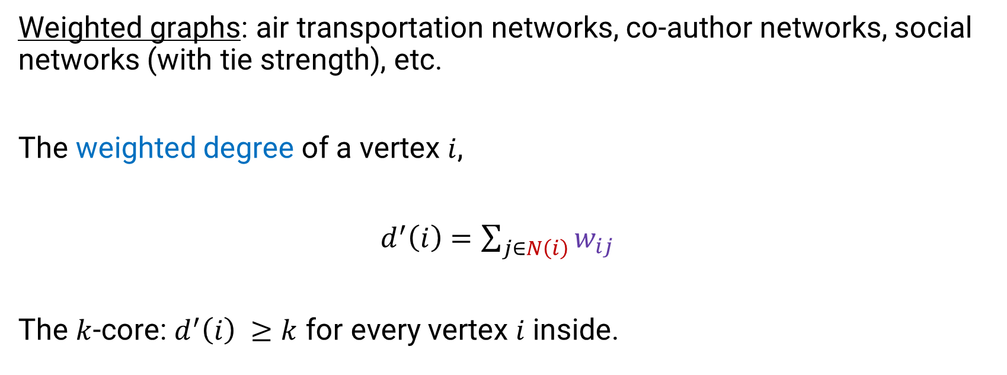
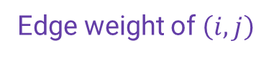
K-Core on Weighted Graphs
Weighted graphs: air transportation networks, co-author networks, social networks (with tie strength), etc.
The weighted degree of a vertex $i$,
$d^{′}\left(i\right)=\sum_{j∈N\left(i\right)}{w_{ij}}$
The $k$-core: $d^{′}\left(i\right) ≥k$ for every vertex $i$ inside.
Neighbor set of i
Edge weight of $\left(i,j\right)$
Eidsaa, Marius, and Eivind Almaas. "S-core network decomposition: A generalization of k-core analysis to weighted networks." Physical Review E 88.6 (2013): 062819.
Garas, Antonios, Frank Schweitzer, and Shlomo Havlin. "A k-shell decomposition method for weighted networks." New Journal of Physics 14.8 (2012): 083030.
Notes:
Two kinds of defnitions. Let $d(i)$ denote the neighbor number of vertex $i$, and $w_{ij}$ denote the weight of $\left(i,j\right).$
N(i) is the neighbor set of i

Slide 74
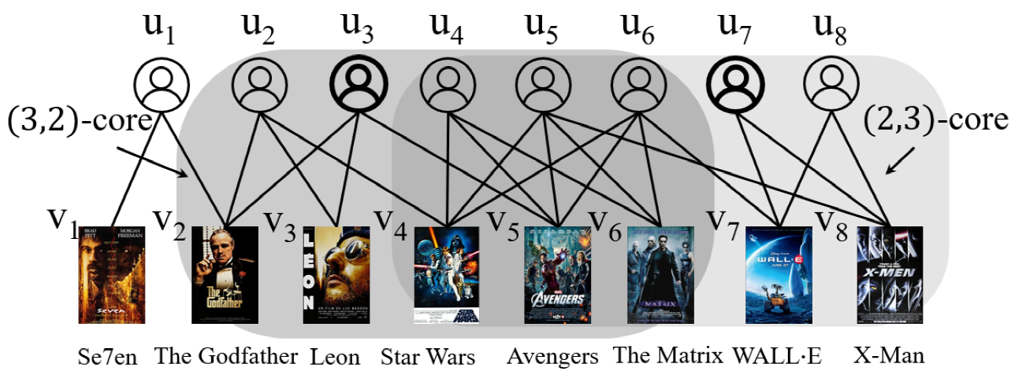
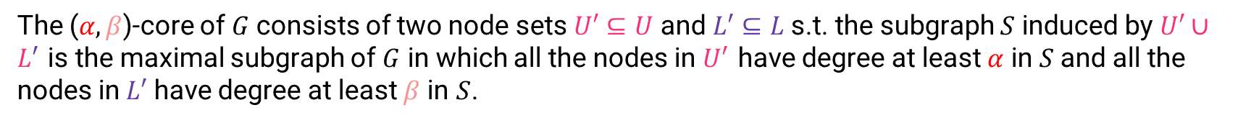
K-Core on Bipartite Graphs
Bipartite graphs: the vertices are divided into two disjoint sets $U$ and $L$ such that every edge connects a vertex in $U$ to one in $L$.
The ($α,β$)-core of $G$ consists of two node sets $U′⊆U$ and $L′⊆L$ s.t. the subgraph $S$ induced by $U′∪L′$ is the maximal subgraph of $G$ in which all the nodes in $U′$ have degree at least $α$ in $S$and all the nodes in$L′$ have degree at least $β$ in $S$.
Liu, Boge, et al. “Efficient (a,b)-core Computation an Index-based Approach”. WWW, 2019.

Slide 75
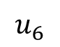
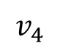
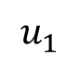
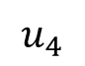
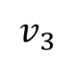
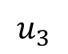
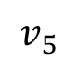
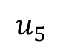





Online computation of (α, β)-core
The algorithm filters out the upper/lower vertices whose degrees are less than alpha/beta (i.e., iteratively remove vertices without enough degrees).
$$u_{1}$$
$$u_{2}$$
$$u_{3}$$
$$u_{4}$$
$$u_{5}$$
$$u_{6}$$
$$v_{1}$$
$$v_{2}$$
$$v_{3}$$
$$v_{4}$$
$$v_{5}$$
$$v_{6}$$
$$v_{7}$$
Example of computing (2,3)-core
Danhao Ding, Hui Li, Zhipeng Huang, and Nikos Mamoulis.2017. Efficient fault-tolerant group recommendation using alpha-beta-core. In Proceedings of the 2017 ACM on Conference on Information and Knowledge Management.2047–2050.
Notes:
Lines 1,2:
The algorithm filters out the vertices whose degrees are less than the minimum of alpha or beta.

Slide 76













Online computation of (α, β)-core
Remove u3 and its incident edges, which are colored red.
$$u_{1}$$
$$u_{2}$$
$$u_{3}$$
$$u_{4}$$
$$u_{5}$$
$$u_{6}$$
$$v_{1}$$
$$v_{2}$$
$$v_{3}$$
$$v_{4}$$
$$v_{5}$$
$$v_{6}$$
$$v_{7}$$
Example of computing (2,3)-core
Danhao Ding, Hui Li, Zhipeng Huang, and Nikos Mamoulis.2017. Efficient fault-tolerant group recommendation using alpha-beta-core. In Proceedings of the 2017 ACM on Conference on Information and Knowledge Management.2047–2050.
Notes:
Lines 5-15: iteratively remove vertices without enough degrees.
Iteration 1: remove u3 and its incident edges, which are colored red.

Slide 77












Online computation of (α, β)-core
Remove v1, v2, v6, v7 and their incident edges, which are colored red.
$$u_{1}$$
$$u_{2}$$
$$u_{4}$$
$$u_{5}$$
$$u_{6}$$
$$v_{1}$$
$$v_{2}$$
$$v_{3}$$
$$v_{4}$$
$$v_{5}$$
$$v_{6}$$
$$v_{7}$$
Example of computing (2,3)-core
Danhao Ding, Hui Li, Zhipeng Huang, and Nikos Mamoulis.2017. Efficient fault-tolerant group recommendation using alpha-beta-core. In Proceedings of the 2017 ACM on Conference on Information and Knowledge Management.2047–2050.
Notes:
Lines 5-15: iteratively remove vertices without enough degrees.
Iteration 2: remove v1, v2, v6, v7 and their incident edges, which are colored red.

Slide 78








Online computation of (α, β)-core
Remove u5, u6 and their incident edges, which are colored red.
$$u_{1}$$
$$u_{2}$$
$$u_{4}$$
$$u_{5}$$
$$u_{6}$$
$$v_{3}$$
$$v_{4}$$
$$v_{5}$$
Example of computing (2,3)-core
Danhao Ding, Hui Li, Zhipeng Huang, and Nikos Mamoulis.2017. Efficient fault-tolerant group recommendation using alpha-beta-core. In Proceedings of the 2017 ACM on Conference on Information and Knowledge Management.2047–2050.
Notes:
Lines 5-15: iteratively remove vertices without enough degrees.
Iteration 3: remove u5, u6 and their incident edges, which are colored red.

Slide 79






Online computation of (α, β)-core
Remove v5 and their incident edges, which are colored red.
$$u_{1}$$
$$u_{2}$$
$$u_{4}$$
$$v_{3}$$
$$v_{4}$$
$$v_{5}$$
Example of computing (2,3)-core
Danhao Ding, Hui Li, Zhipeng Huang, and Nikos Mamoulis.2017. Efficient fault-tolerant group recommendation using alpha-beta-core. In Proceedings of the 2017 ACM on Conference on Information and Knowledge Management.2047–2050.
Notes:
Lines 5-15: iteratively remove vertices without enough degrees.
Iteration 3: remove v5 and their incident edges, which are colored red.

Slide 80





Online computation of (α, β)-core
Return the subgraph when all vertices satisfy the degree constraints.
$$u_{1}$$
$$u_{2}$$
$$u_{4}$$
$$v_{3}$$
$$v_{4}$$
Example of computing (2,3)-core
Danhao Ding, Hui Li, Zhipeng Huang, and Nikos Mamoulis.2017. Efficient fault-tolerant group recommendation using alpha-beta-core. In Proceedings of the 2017 ACM on Conference on Information and Knowledge Management.2047–2050.
Notes:
Return the subgraph when all vertices satisfy the degree constraints.

Slide 81
Other Models

Slide 82
Why not k-core?

Slide 83
K-Truss
A maximal subgraph where each edge is contained in at least k-2 triangles in the subgraph, i.e., each edge has a support of at least k-2 in the subgraph.
J. Cohen. Trusses: Cohesive subgraphs for social network analysis. National Security Agency Technical Report, page 16, 2008.
The strength of a tie can be estimated by the number of triangles containing it.
M. Wang, C. Wang, J. X. Yu, and J. Zhang, Community detection in social networks: An in-depth benchmarking study with a procedure-oriented framework. PVLDB, 8(10):998–1009, 2015.
High quality on some community metrics.
High accuracy on approximating some ground-truth communities.
The most efficient one among all the evaluated algorithms.

Slide 84

Properties of k-Truss
A maximal subgraph where each edge is contained in at least k-2 triangles in the subgraph.
Each k-truss of G is a subgraph of a $(k−1)$-core of G.
Proof scratch:
- Each edge is contained in at least k-2 triangle.
- To ensure this, each vertex should have at least k-1 neighbors, i.e., for a vertex u, if the edge (u, v) is contained in k-2 triangles, there should be at least k-2 common neighbors of u and v.
Cohen, Jonathan. "Trusses: Cohesive subgraphs for social network analysis." National Security Agency Technical Report16 (2008): 3-1.

Slide 85













K-Truss Computation
Compute the (k-1)-core.
Compute the support of each edge.
Recursively delete each edge with support of less than k-2.
Delete the isolated vertices.
$$v_{2}$$
$$k=4$$
$$v_{5}$$
$$v_{10}$$
$$v_{8}$$
$$v_{1}$$
$$v_{3}$$
$$v_{6}$$
$$v_{11}$$
$$v_{9}$$
$$v_{7}$$
$$v_{4}$$
$$v_{12}$$

Slide 86
K-Truss Computation
Compute the (k-1)-core.
Compute the support of each edge.
Recursively delete each edge with support of less than k-2.
Delete the isolated vertices.
$$v_{2}$$
$$k=4$$
$$v_{5}$$
$$v_{10}$$
$$v_{8}$$
$$v_{1}$$
$$v_{3}$$
$$v_{6}$$
$$v_{11}$$
$$v_{9}$$
$$v_{7}$$
$$v_{4}$$
$$v_{12}$$

Slide 87





















K-Truss Computation
Compute the (k-1)-core.
Compute the support of each edge.
Recursively delete each edge with support of less than k-2.
Delete the isolated vertices.
$$v_{2}$$
$$k=4$$
$$2$$
$$v_{5}$$
$$v_{10}$$
$$2$$
$$2$$
$$2$$
$$2$$
$$1$$
$$3$$
$$2$$
$$v_{8}$$
$$v_{1}$$
$$v_{3}$$
$$v_{6}$$
$$3$$
$$2$$
$$2$$
$$3$$
$$3$$
$$v_{11}$$
$$1$$
$$3$$
$$2$$
$$2$$
$$2$$
$$v_{9}$$
$$2$$
$$v_{7}$$
$$2$$
$$v_{4}$$
$$2$$
$$v_{12}$$

Slide 88
K-Truss Computation
Compute the (k-1)-core.
Compute the support of each edge.
Recursively delete each edge with support of less than k-2.
Delete the isolated vertices.
$$v_{2}$$
$$k=4$$
$$2$$
$$v_{5}$$
$$v_{10}$$
$$2$$
$$2$$
$$2$$
$$2$$
$$1$$
$$3$$
$$2$$
$$v_{8}$$
$$v_{1}$$
$$v_{3}$$
$$v_{6}$$
$$3$$
$$2$$
$$2$$
$$3$$
$$3$$
$$v_{11}$$
$$1$$
$$3$$
$$2$$
$$2$$
$$2$$
$$v_{9}$$
$$2$$
$$v_{7}$$
$$2$$
$$v_{4}$$
$$2$$
$$v_{12}$$

Slide 89




K-Truss Computation
Compute the (k-1)-core.
Compute the support of each edge.
Recursively delete each edge with support of less than k-2.
Delete the isolated vertices.
$$v_{2}$$
$$k=4$$
$$1$$
$$v_{5}$$
$$v_{10}$$
$$1$$
$$2$$
$$2$$
$$2$$
$$3$$
$$2$$
$$v_{8}$$
$$v_{1}$$
$$v_{3}$$
$$v_{6}$$
$$3$$
$$2$$
$$2$$
$$3$$
$$3$$
$$v_{11}$$
$$3$$
$$1$$
$$2$$
$$2$$
$$v_{9}$$
$$2$$
$$v_{7}$$
$$2$$
$$v_{4}$$
$$1$$
$$v_{12}$$

Slide 90







K-Truss Computation
Compute the (k-1)-core.
Compute the support of each edge.
Recursively delete each edge with support of less than k-2.
Delete the isolated vertices.
$$v_{2}$$
$$k=4$$
$$v_{5}$$
$$v_{10}$$
$$1$$
$$1$$
$$2$$
$$2$$
$$2$$
$$v_{8}$$
$$v_{1}$$
$$v_{3}$$
$$v_{6}$$
$$3$$
$$0$$
$$2$$
$$3$$
$$3$$
$$v_{11}$$
$$2$$
$$1$$
$$2$$
$$v_{9}$$
$$1$$
$$v_{7}$$
$$2$$
$$v_{4}$$
$$v_{12}$$

Slide 91




K-Truss Computation
Compute the (k-1)-core.
Compute the support of each edge.
Recursively delete each edge with support of less than k-2.
Delete the isolated vertices.
$$v_{2}$$
$$k=4$$
$$v_{5}$$
$$v_{10}$$
$$2$$
$$2$$
$$2$$
$$v_{8}$$
$$v_{1}$$
$$v_{3}$$
$$v_{6}$$
$$3$$
$$0$$
$$3$$
$$3$$
$$v_{11}$$
$$2$$
$$2$$
$$v_{9}$$
$$v_{7}$$
$$2$$
$$v_{4}$$
$$v_{12}$$

Slide 92
K-Truss Computation
Compute the (k-1)-core.
Compute the support of each edge.
Recursively delete each edge with support of less than k-2.
Delete the isolated vertices.
$$v_{2}$$
$$k=4$$
$$v_{5}$$
$$v_{10}$$
$$2$$
$$2$$
$$2$$
$$v_{8}$$
$$v_{1}$$
$$v_{3}$$
$$v_{6}$$
$$3$$
$$3$$
$$3$$
$$v_{11}$$
$$2$$
$$2$$
$$v_{9}$$
$$v_{7}$$
$$2$$
$$v_{4}$$
$$v_{12}$$

Slide 93

K-Truss Computation
Compute the (k+1)-core.
Compute the support of each edge.
Recursively delete each edge with support of less than k-2.
Delete the isolated vertices.
$4$-truss
$$v_{2}$$
$$k=4$$
$$v_{5}$$
$$v_{10}$$
$$2$$
$$2$$
$$2$$
$$v_{8}$$
$$v_{1}$$
$$v_{3}$$
$$v_{6}$$
$$3$$
$$3$$
$$3$$
$$v_{11}$$
$$2$$
$$2$$
$$v_{9}$$
$$v_{7}$$
$$2$$
$$v_{4}$$
$$v_{12}$$

Slide 94



Compute the support of each edge - Triangle Counting
Edge-iterator: Given an edge (u, v), any triangle that includes the edge must contain a third vertex w that has connections to both of u and v. Thus, we can obtain any triangles containing edge (u, v) based on the intersection of N(u) and N(v). For each edge, the edge-iterator returns the set of triangles associated with that edge, and when repeated on all edges, the set of all triangle solutions is made available.
$$u$$
$$w$$
$$v$$
Duplication: If we use the above method to calculate the triangles, then we will count a triangle repeatedly.
Coding practice~
Latapy, M. (2008). Main-memory triangle computations for very large (sparse (power-law)) graphs. Theoretical computer science, 407(1-3), 458-473.

Slide 95
Compute the support of each edge - Triangle Counting
Priority: The priority of vertices can be determined by the degree of each vertex. The smaller the degree; the smaller the priority. If the degrees of two vertices are the same, it can be determined by the alphabetical order or numerical order of the vertices.
$$u$$
Orientation technique (without duplication): Each undirected edge is mapped to a directed edge where the direction (i.e., orientation) is decided by the priority of its endpoints in the vertex-ordering (i.e., u->v if u has a smaller priority than v). We refer to vertex u as a pivot vertex if u has two out-going edges. We can association a triangle in the undirected graph with only one pivot vertex to ensure one and only one instance of this triangle in the output, which significantly improves the performance.
$$w$$
$$v$$
Latapy, M. (2008). Main-memory triangle computations for very large (sparse (power-law)) graphs. Theoretical computer science, 407(1-3), 458-473.

Slide 96


Compute the support of each edge - Triangle Counting
Compact Forward (CF) Algorithm: We denote the set of outgoing-neighbors of vertex u in G as$N^{+}\left(u\right)$, and the out-degree as $\deg^{+}\left(u\right)=\left|N^{+}\left(u\right)\right|.$In line 1, undirected graph G is transformed into a directed graph G via the orientation technique. (Line 2 onward follows the edge-iterator framework.) In Line 3, triangles are enumerated by iterating through the outgoing neighborhoods rather than the full neighborhood. In Line 4, a merge-based intersection identifies the common out-going neighbors of u and v, denoted by T. A set of triangles (u, v, w) is then output for every vertex w ∈ T.
$$u$$
$$w$$
$$v$$

Slide 97

Compute the support of each edge - Triangle Counting
The adjacency list of each vertex is unsorted: The time complexity of CF algorithm is: $O(\sum_{(u,v)∈E}{\deg^{+}\left(u\right)∗\deg^{+}\left(v\right)})$.
Proof: We need to check whether there are common neighbors in the adjacency list of u and v. For each neighbor of u, we need to check $\deg^{+}\left(v\right)$times in the adjacency list of v, u has $\deg^{+}\left(u\right)$ neighbors, so the time complexity of finding common neighbor of two vertices (line 4 in the pseudo code) is $O(\deg^{+}\left(u\right)∗\deg^{+}\left(v\right))$. Thus, the total time complexity of CF algorithm is: $O(\sum_{(u,v)∈E}{\deg^{+}\left(u\right)∗\deg^{+}\left(v\right)})$.
For the sake of brevity, here we only give the out-neighbors of u and v and the degree of vertices other than u, v is higher than the degree of u, v.
A
B
D
E
F
I
Adjacency list of u:
N⁺ (u)
B | A | D | I | F | E
Adjacency list of v:
N⁺ (v)
B | F | I
u
v

Slide 98

Compute the support of each edge - Triangle Counting
If the adjacency list of each vertex is sorted, the merge-based intersection operation at Line 4 takes $O(\deg^{+}\left(u\right)+\deg^{+}\left(v\right))$. The time complexity of CF algorithm is: $O(\sum_{(u,v)∈E}{\deg^{+}\left(u\right)+\deg^{+}\left(v\right)})$.
A
B
D
E
F
I
Ordered adjacency list of u:
N⁺ (u)
A | B | D | E | F | I
Ordered adjacency list (with order) of v:
N⁺ (v)
B | F | I
u
v

Slide 99


Compute the support of each edge - Triangle Counting
Suppose a hash table has been built for each vertex based on the out-going neighbors in the oriented graph. At Line 4 of Algorithm CF, we may choose the vertex with larger number of neighbors as the hash table for intersection operation with $O(min⁡(\deg^{+}\left(u\right)，\deg^{+}\left(v\right)))$ look-up cost.
A hash table has been built for each vertex: The time complexity of CF algorithm is: $O(\sum_{\left(u,v\right)∈E}{min⁡(\deg^{+}\left(u\right)，\deg^{+}\left(v\right)}))$ = $O(α ⋅m)$ = $O(m^{1.5})$.
Graph arboricity

Slide 100
Compute the support of each edge - Triangle Counting
Adjacency list of u:
N⁺(u)
A | B | D | E | F | I
Adjacency list of v:
N⁺ (v)
B | F | I
Choosing the vertex with larger number of neighbors as the hash table for intersection operation.
0
1
2
3
4
5
6
…
E
Here is an example of u’s hash table. We use division hashing to make this hash table. The value of the vertex is replaced by the corresponding number (A: 1, B: 2, D: 4, E: 5, F: 6, I: 9) and the hash function used is X % 5.
Because the query time complexity of hash table is O(1), we only need to query $\deg^{+}\left(v\right)$ times.
Final result: there are two common neighbors B and C.
A
F
B
D
I

Slide 101

Compute the support of each edge - Triangle Counting
Building a hash table for neighbors of each vertex takes too much space for big graphs
A hash table is being built on the fly: The time complexity of CF algorithm is: $O\left(\sum_{\left(u,v\right)∈E^{′}}{\deg^{+}(v)}\right)=O\left(\sum_{\left(u,v\right)∈E^{′}}{deg(v)}\right)=O\left(\sum_{\left(u,v\right)∈E}{min⁡(\deg\left(u\right),deg \left(v\right))}\right)$
= $O(α ⋅m)$ = $O(m^{1.5})$.
Coding practice~
E’: the set of all directed edges

Slide 102


K-Edge Connected Component
$3$-$ECC$s
A graph is $k$-edge connected if it is still connected after removing any set of $k−1$ edges from it.
A $k$-Edge Connected Component ($k$-$ECC$) is a maximal $k$-edge connected subgraph

Slide 103

K-Vertex Connected Component
A graph is $k$-vertex connected if it is still connected after removing any set of $k−1$ vertices from it.
A $k$-Vertex Connected Component ($k$-$VCC$) is a maximal $k$-vertex connected subgraph.

Slide 104

Cliques
Every pair of vertices pair is connected
A clique is called maximal clique if there exist no other bigger cliques that contain it
Also called complete graph
R. D. Luce and A. D. Perry, “A method of matrix analysis of group structure,” Psychometrika, vol. 14, no. 2, pp. 95–116, 1949
Notes:
Familiarity, reachability, robustness

Slide 105



Variations of cliques: quasi-clique
Quasi-clique: relax on density or degree.
total # of edges: $\frac{|V|(\left|V\right|−1)}{2}$ to
$γ$ $\frac{|V|(\left|V\right|−1)}{2}$
$γ=0.8$
H. Matsuda, T. Ishihara, A. Hashimoto. Classifying molecular sequences using a linkage graph with their pairwise similarities. Theor. Comput. Sci., 1999
Notes:
Quasi c

Slide 106
Cohesive Subgraph Models
Global cohesiveness: cliques and variants
Node and edge constraints: k-core, k-truss
Connectivity: k-ECC, k-VCC

Slide 107
Comparison of models
Cohesive level
Core-based-models
Truss-based-models
Clique-based-models
Computation complexity
Danhao Ding, Hui Li, Zhipeng Huang, and Nikos Mamoulis.2017. Efficient fault-tolerant group recommendation using alpha-beta-core. In Proceedings of the 2017 ACM on Conference on Information and Knowledge Management.2047–2050.
Z.Zou, “Bitruss decomposition of bipartite graphs,” in DASFAA. Springer, 2016, pp. 218–233.
Yun Zhang, Charles A Phillips, Gary L Rogers, Erich J Baker, Elissa J Chesler, and Michael A Langston. 2014. On finding bicliques in bipartite graphs:a novel algorithm and its application to the integration of diverse biological data types. BMC bioinformatics 15,1(2014),110.

Slide 108
Learning Outcome
- Know the definition of the introduced cohesive subgraph models
- Understand the algorithms to compute k-core and the process to compute k-truss

Slide 109
Core Decomposition: Local-view (Converging)
Locality Theorem:
Given a vertex and its core number k:
There exists at least k neighbors with core number k;
There does not exist k+1 neighbors with core number k+1.
3
4
3
4
4
Core(V) = 3
4 neighbors with core number at least 3
√
3
v
3
v
6
v
6
6
Core(V) = 4
Only 2 neighbors with core number at least 4
×
1
2
Montresor, Alberto, Francesco De Pellegrini, and Daniele Miorandi. "Distributed k-core decomposition." IEEE Transactions on parallel and distribuated systems 24.2 (2013): 288-300.

Slide 110
Core Decomposition: Local-view (Converging)
v₀
v₆
v₇
Given a vertex and its core number k:
There exists at least k neighbors with core number k;
There does not exist k+1 neighbors with core number k+1.
v₃
v₅
v₁
v₄
v₈
v₂
False
True
Initialize the core number by degree
Iteration 1
isContinue:
ID
0
1
2
3
4
5
6
7
8
Core
3
3
4
6
3
5
3
2
1

Slide 111
Core Decomposition: Local-view (Converging)
v₀
v₆
v₇
Given a vertex and its core number k:
There exists at least k neighbors with core number k;
There does not exist k+1 neighbors with core number k+1.
v₃
v₅
v₁
v₄
v₈
v₂
False
True
Initialize the core number by degree
Iteration 1
isContinue:
ID
0
1
2
3
4
5
6
7
8
Core
3
3
4
6
3
5
3
2
1

Slide 112
Core Decomposition: Local-view (Converging)
v₀
v₆
v₇
Given a vertex and its core number k:
There exists at least k neighbors with core number k;
There does not exist k+1 neighbors with core number k+1.
v₃
v₅
v₁
v₄
v₈
v₂
True
False
True
Initialize the core number by degree
Iteration 1
isContinue:
ID
0
1
2
3
4
5
6
7
8
Core
3
3
3
4
6
3
5
3
2
1
Notes:
???

Slide 113
Core Decomposition: Local-view (Converging)
v₀
v₆
v₇
Given a vertex and its core number k:
There exists at least k neighbors with core number k;
There does not exist k+1 neighbors with core number k+1.
v₃
v₅
v₁
v₄
v₈
v₂
True
False
True
Initialize the core number by degree
Iteration 1
isContinue:
ID
0
1
2
3
4
5
6
7
8
Core
3
3
3
4
3
6
3
5
3
2
1

Slide 114
Core Decomposition: Local-view (Converging)
v₀
v₆
v₇
Given a vertex and its core number k:
There exists at least k neighbors with core number k;
There does not exist k+1 neighbors with core number k+1.
v₃
v₅
v₁
v₄
v₈
v₂
True
Fals
True
Initialize the core number by degree
Iteration 1
isContinue:
ID
0
1
2
3
4
5
6
7
8
Core
3
3
4
3
3
6
3
5
3
2
1

Slide 115
Core Decomposition: Local-view (Converging)
v₀
v₆
v₇
Given a vertex and its core number k:
There exists at least k neighbors with core number k;
There does not exist k+1 neighbors with core number k+1.
v₃
v₅
v₁
v₄
v₈
v₂
True
False
True
Initialize the core number by degree
Iteration 1
isContinue:
ID
0
1
2
3
4
5
6
7
8
Core
3
3
4
3
3
6
3
5
3
3
2
1

Slide 116
Core Decomposition: Local-view (Converging)
v₀
v₆
v₇
Given a vertex and its core number k:
There exists at least k neighbors with core number k;
There does not exist k+1 neighbors with core number k+1.
v₃
v₅
v₁
v₄
v₈
v₂
False
True
isContinue:
Initialize the core number by degree
Iteration 1
True
ID
0
1
2
3
4
5
6
7
8
Core
3
3
4
3
3
6
3
5
3
2
3
2
1

Slide 117
Core Decomposition: Local-view (Converging)
v₀
v₆
v₇
Given a vertex and its core number k:
There exists at least k neighbors with core number k;
There does not exist k+1 neighbors with core number k+1.
v₃
v₅
v₁
v₄
v₈
v₂
False
True
True
Initialize the core number by degree
Iteration 1
isContinue:
ID
0
1
2
3
4
5
6
7
8
Core
3
3
4
3
3
6
3
5
3
2
3
2
1

Slide 118
Core Decomposition: Local-view (Converging)
v₀
v₆
v₇
Given a vertex and its core number k:
There exists at least k neighbors with core number k;
There does not exist k+1 neighbors with core number k+1.
v₃
v₅
v₁
v₄
v₈
v₂
True
False
True
Initialize the core number by degree
Iteration 1
isContinue:
ID
0
1
2
3
4
5
6
7
8
Core
3
3
4
3
3
6
3
5
3
2
3
2
1

Slide 119
Core Decomposition: Local-view (Converging)
v₀
v₆
v₇
Given a vertex and its core number k:
There exists at least k neighbors with core number k;
There does not exist k+1 neighbors with core number k+1.
v₃
v₅
v₁
v₄
v₈
v₂
True
Initialize the core number by degree
Iteration 1
isContinue:
ID
0
1
2
3
4
5
6
7
8
Core
3
3
4
3
3
6
3
5
3
2
3
2
1

Slide 120
Core Decomposition: Local-view (Converging)
v₀
v₆
v₇
Given a vertex and its core number k:
There exists at least k neighbors with core number k;
There does not exist k+1 neighbors with core number k+1.
v₃
v₅
v₁
v₄
v₈
v₂
False
True
Initialize the core number by degree
Iteration 1
isContinue:
2
ID
0
1
2
3
4
5
6
7
8
Core
3
3
4
3
3
6
3
5
3
2
3
2
1

Slide 121
Core Decomposition: Local-view (Converging)
v₀
v₆
v₇
Given a vertex and its core number k:
There exists at least k neighbors with core number k;
There does not exist k+1 neighbors with core number k+1.
v₃
v₅
v₁
v₄
v₈
v₂
True
Initialize the core number by degree
Iteration 1
isContinue:
False
2
ID
0
1
2
3
4
5
6
7
8
Core
3
3
4
3
3
6
3
2
5
3
2
3
2
1

Slide 122
Core Decomposition: Local-view (Converging)
v₀
v₆
v₇
Given a vertex and its core number k:
There exists at least k neighbors with core number k;
There does not exist k+1 neighbors with core number k+1.
v₃
v₅
v₁
v₄
v₈
v₂
True
True
False
Initialize the core number by degree
Iteration 1
isContinue:
2
3
ID
0
1
2
3
4
5
6
7
8
Core
3
3
4
3
3
6
3
2
2
5
3
2
3
2
1

Slide 123
Core Decomposition: Local-view (Converging)
v₀
v₆
v₇
Given a vertex and its core number k:
There exists at least k neighbors with core number k;
There does not exist k+1 neighbors with core number k+1.
v₃
v₅
v₁
v₄
v₈
v₂
True
False
True
Fals
Iteration 1
isContinue:
Initialize the core number by degree
4
2
3
ID
0
1
2
3
4
5
6
7
8
Core
3
3
4
3
3
6
3
2
2
5
3
2
3
2
1

